Slide 1
Modeling the Axon
Noah Weiss & Susan Koons
Notes:
[NOAH: I have put comments in [square brackets], potential additions or clarifications in {squiggly brackets}, and stage directions in <angle brackets>.]

Slide 2
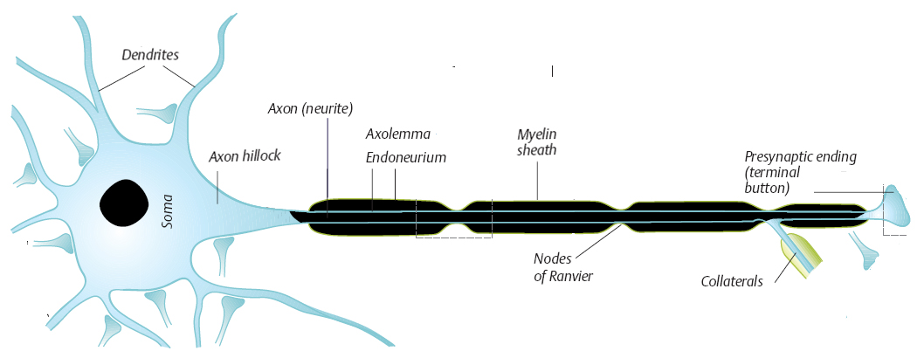
Neuron Anatomy
Notes:
Susan: Action Potentials (Electrical pulses generated by neurons) begin at the initial node after a signal from the cell body, or the Soma. The pulse then travels down the axon, insulated by the myelin sheath everywhere but at the Nodes of Ranvier. Here, there are Ion channels that allow electrical signals to pass through. The myelin is made of layers of water and fat, which serve as an insulator and block any ion channels that may occur between Nodes of Ranvier. Finally, at the terminal button, the pulse is transmitted across the synaptic gap to the dendrites of another cell.

Slide 3
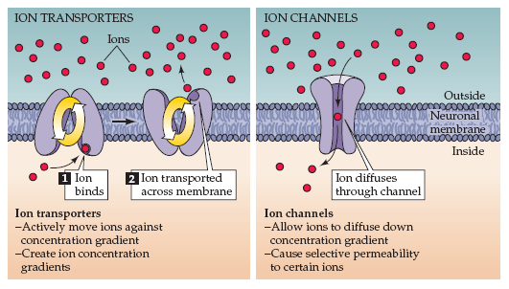
Ion Movement
Neuroscience: 3ed
Notes:
Susan: Ion Transporters <Point to the pump picture> are active “pumps” that use cellular energy to transport ions against the concentration gradient, from areas of low concentration to areas of high concentration. Ion Channels <Point to diffuser picture> are passive, in that they do not use cellular energy, and diffuse ions from areas of high concentration to areas of low concentration

Slide 4
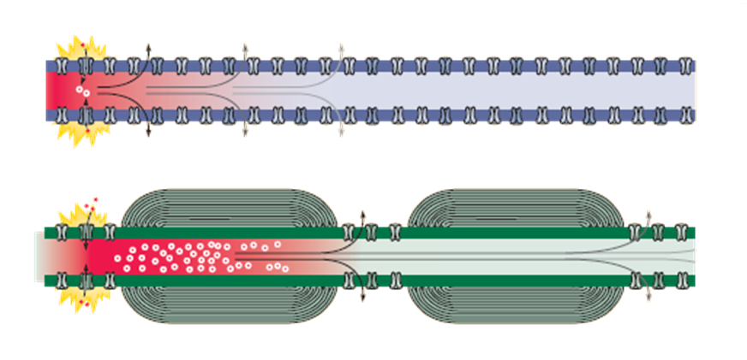
Biological Significance of Myelination
Neuroscience: 3ed
Notes:
Susan: Myelination is very important to the transmission of neural impulses. It increases transmission speed by insulating the electrical impulse from leaks. Electrically, it reduces the capacitance of the membrane, which reduces the amount of charge that can be stored in these regions. Therefore less current can leak. <Cycle through the next three slides.>

Slide 5
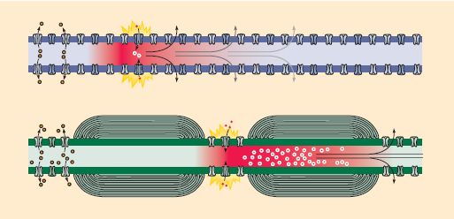
Biological Significance of Myelination
Neuroscience: 3ed

Slide 6
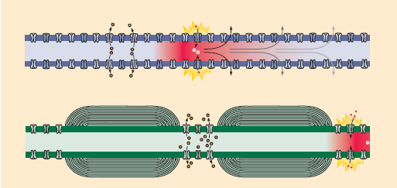
Biological Significance of Myelination
Neuroscience: 3ed
Notes:
Susan: The fewer ion channels available, as in a myelinated axon, the more quickly the pulse can move, because ion exchange takes a certain amount of time.

Slide 7


Circuit Notation
Resistors: Linear or non-linear
  F(V,I)=0 V=IR
  I=f(V) V = h(I)
Capacitors:
Pumps:
Notes:
Noah: We can use a circuit notation in order to model the axon. All of the circuit elements have an IV characteristic. The general form of any circuit element is F(V,I) = 0 <Point to diamond> Resistors are a common dissipater of current, and they come in several varieties. Special cases of the general resistor are the linear resistor, which gives V=IR, our familiar Ohm’s law <Point to V=IR>. There are “S” shaped and “N” shaped resistance curves, which are named as such when you plot the characteristic on the axis where x=V and y=I. <Point to them and say their equations aloud.>
Capacitors have a basic relationship of Q = CV, which easily gets us to CV’=I <Point to capacitor>. The ion pumps may not be as familiar—we take them to act like one-way inductors, and thus have the equation A’=λVA, where V is the voltage across the pump. <Point to pump>

Slide 8
Circuit Laws
Kirchhoff’s Current Law:
The principle of conservation of electric charge implies that:
The sum of currents flowing towards a point is equal to the sum of currents flowing away from that point.
i₂
i₃
i₁
i₁ = i₂ + i₃
Notes:
Noah: In order to fully describe the system, we need Kirchhoff’s laws, which are a basic part of circuit theory. The current law, also known as the junction rule, states that the sum of currents flowing toward a point is equal to the sum of the currents that flow away from the point. <Point at the picture.>

Slide 9
Circuit Laws
Kirchhoff’s Voltage Law
The directed sum of the electrical potential differences around any closed circuit must be zero. (Conservation of Energy)
V_{R1} + V_{R2} + V_{R3} + V_{C} =0
R₂
R₁
R₃
Notes:
Noah: The other law is the voltage law, also called the loop rule. The directed sum of potential differences around a closed circuit must be zero. <Point at picture> For example, in this picture, we have <Read off the equation shown>.

Slide 10
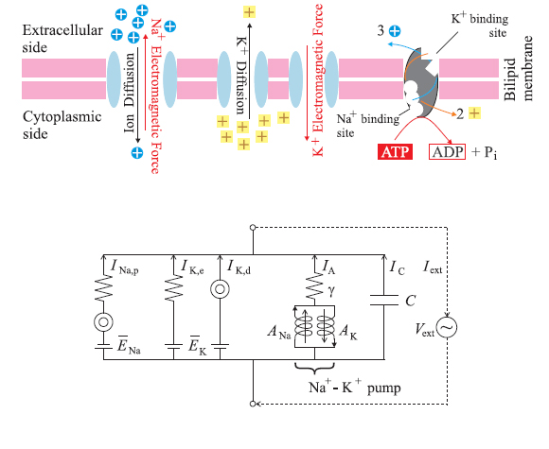
Circuit Model
Notes:
Noah: This circuit model represents one node of Ranvier, in that it contains the active and passive channels that allow for ion exchange. The Ion diffusion that occurs through the passive channels is represented by a diffuser <point to diffuser symbol> and the EMF {electro-motive force} is represented by a battery. Furthermore, ion exchange involves resistance, so there is a resistor included in each branch. In this model, the Sodium channels are together, and are represented by a serial branch, and the Potassium channels are parallel, represented by a parallel branch. This is the opposite configuration of the model Adrienne and Ty presented earlier [So they are going first? yes]. Furthermore, the active pump has been represented as 2 parallel inductors in series with a resistor, and the cell membrane is represented by a capacitor.

Slide 11
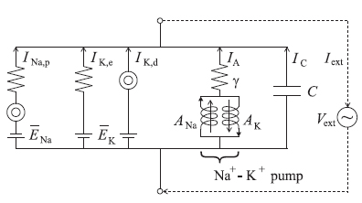
Circuit Model
Neurons can be modeled with a circuit model
  Each circuit element has an IV characteristic
  The IV characteristics lead to differential equation(s)
Use Kirchhoff’s laws and IV characteristics to get the differential equations
Notes:
Noah: So, as we have seen, the node of Ranvier may be modeled with a circuit. As each node has the IV characteristics that were previously mentioned, we can use them, combined with Kirchhoff’s laws, to distill a system of differential equations that will help us to describe the behavior of the electric currents.

Slide 12
Equations- Circuit Model
Solve for and use
To find use the current law:
  Additionally, define the absolute current
  Assume a linear resistor with (small) resistance γ in series with the pumps
Use Kirchhoff’s laws to get:
Notes:
Noah: We begin by using the current law, and obtain I_C – I_ext – I_A – I_Na – I_K = 0. If we solve this equation for I_C and use its IV curve, we obtain a differential equation. Then, we can simplify it by using the voltage law on the potassium channel—it implies that that function is an “N”-shaped curve. This gives the first equation here <Point to the first equation>. We define I_A = A_Na – A_K, and I_S = A_Na + A_K to be the active current and absolute currents, respectively. Using the voltage law on a loop with the pumps and the capacitor, we can obtain the second and third equations of the system <Point to these equations>. Finally, the passive sodium channel is an “S”-shaped curve by usage of the current law. We use the voltage law to obtain the fourth equation, but need a singular perturbation from nonlinear circuit theory for this to work, so let 0<eps<<1. This gives us the set of four equations with four unknowns.

Slide 13
Reducing Dimensions
Assume the “N” curve doesn’t interact with the “S” curve
  All three parts of “N” are within primary branch of “S”
  Also, let ε = 0:
I
V
K
Na
Notes:
Noah: Although we have a four-dimensional equation, one assumption allows us to reduce it to a two-dimensional equation, which would allow us to graph the nullclines easily. We assume that the potassium (“N” shaped) curve doesn’t interact with the sodium (“S” shaped) curve. In particular, this happens if both “knee points” of the potassium curve <Point to them> correspond to the primary branch of the sodium curve <Point to it>. Then, for the singular perturbed fourth equation, we idealize it by letting ε vanish. Re-arranging , we get the following system below <Point to it and wait a half-second>. The key point is that this fourth equation is linear.

Slide 14
Reducing Dimensions
Substitute the 4th equation into the 1st
Nullclines: Set the derivatives equal to zero
  Nontrivial nullcline in the 2nd and 3rd equations are same
  Re-arrange and obtain the following:
Notes:
Noah: Now, we can substitute the fourth equation from the previous slide into the first equation, which gives us the three equations right here <Point to it and wait a second>. Here, we can consider the nullclines, or the surfaces where the derivatives are equal to zero. By setting each derivative equal to zero, notice that the non-trivial nullclines on the second and third equations <point to them> are identical. Thus, we now have only two variables: I_A and V_C. This is something that we can graph!

Slide 15
Resting Potential
Let
  Analyze the nullclines: vector field directions
  Assume C<<1: singular perturbation
  nullcline intersects nullcline in primary branch
I_{A}
I_{A} nullcline
V_{C} nullcline
V_{c}
Notes:
Noah: We start with the resting potential, where we assume that there is no external current. Here, we want everything to eventually converge to a stable equilibrium point. To do this, we first notice that the derivative for I_A is zero on its nullcline <Point to blue nullcline> and similarly for V_C <Point to red nullcline>. Now, we find the sign of the variable on each side of the nullcline, which corresponds to a vector field direction. We obtain these general directions <Click to show the green arrows>. However, we are assuming that C<<1, which is a singular perturbation. In particular, this makes the V_C solution “fast” so that the solution goes more horizontal than vertical, until it nears the V_C nullcline where the “slow” solution takes over and the solution follows the nullcline. [I think this sentence is awkward, but I’m not sure how to streamline it, or if I’m being way too technical and/or wordy here]. Taking several initial conditions <Click to show one solution>, we see that regardless of the initial condition in this case <Click to show another>, they will all converge to the equilibrium point <Click to show the last>. This will happen if the I_A and V_C nullclines intersect in V_C’s primary branch.

Slide 16
Action Potential Conditions
Increase to shift the nullcline upward
To get an action potential:
Notes:
Noah: Now, we consider the previous picture, but we want to increase the external current. This will shift the V_C nullcline upward. <Click to show it.> The nullcline analysis is exactly the same as the previous case, so let’s consider an initial condition and follow the phase plane. <Click to show the initial condition>. As this solution approaches the V_C nullcline, it then follows it after passing it, but turns once it reaches the bottom of the nullcline <Click again>. The solution continues to the second primary branch <Click>, and goes from the turning point back to the first primary branch. This cycle repeats since the time scales are different. So, if V_C is a fast variable and the nullclines intersect in the diffusive branch, we will get an action potential.

Slide 17
Action Potential Conditions
The “N” curve has 2 “knee” points at
The “S” curve is merely linear by assumption (i.e. is constant)
Some algebra shows that must satisfy:
>=
Notes:
Noah: Now, some technical details. We call the knee points of the “N” curve V_1 and V_2. Then, we define the “N” curve piecewise-linear, where G_2 is the diffusion constant and G_1 is the conduction constant. In order to get our picture, G_2 > G_1. This equation is given right here <Point to it>. As we assumed earlier, the “S” shaped curve is linear, so we get the expression g_Na(V_C – E_Na) as shown above <Point to it just for good measure>. Now, we want to solve for what external current will give us the action potential configuration. The necessary condition is that V_C is between the knee points, and which leads to a condition on I_ext

Slide 18
Circuit Equations of a Node
Notes:
Noah: Let’s review our four-dimensional system of equations. This equation is for a single node of Ranvier. <Pause for a second or two.> We can use this equation to generalize to the multiple node situation of an axon.

Slide 19
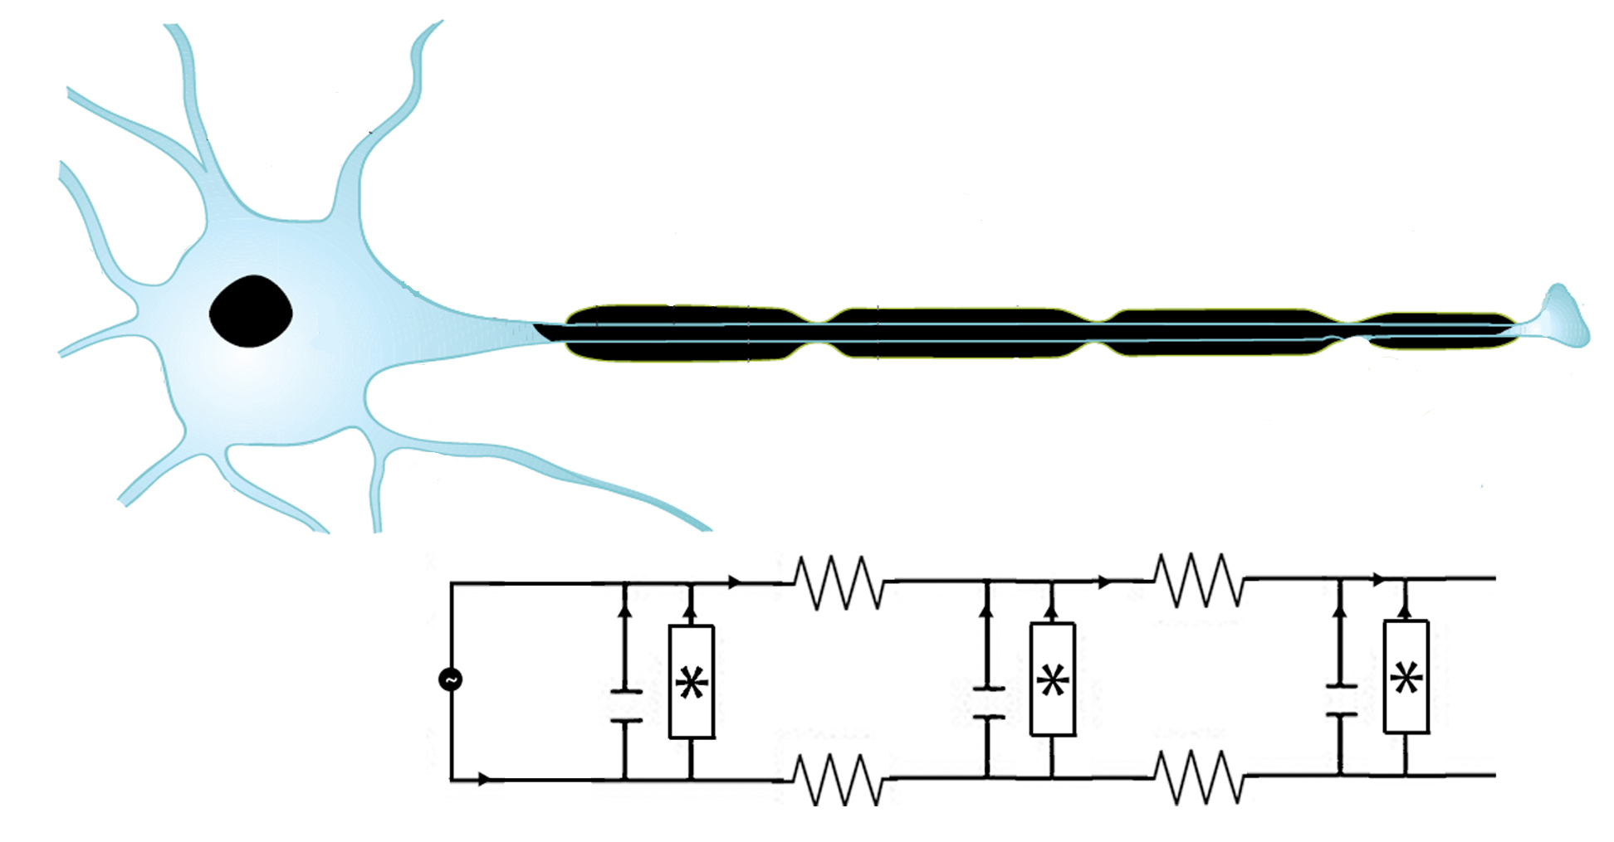
Multiple Nodes
Inside the cell
Outside the cell
Notes:
Noah: By linking multiple nodes together with resistors in between, we can represent an axon. The external current is injected into the circuit by the cell body <Point to it>, and then passes through alternating nodes <Point to one> and myelinated segments <Point to one>. Each node is then represented by the equations previously derived.

Slide 20
Multiple Nodes
Recall the equations for one node:
  There is no outgoing current
Consider a second node that is not coupled to the first node
  It should have the same equation (but with different currents)
Notes:
Noah: The equations for one node are given here <Point to the top system>. Let’s consider a second node, and temporarily assume that these nodes are independent from each other. If they are identical, the equation is the same. Here, a superscript is used to indicate which node is being considered. <Point to bottom equations.> The currents and voltages may be different, and the parameters (like resistances and emf’s) can be different as well. However, for simplicity, in the work we have completed, all nodes are the same with respect to parameters.

Slide 21
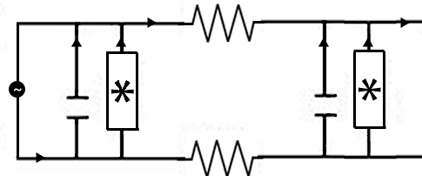
Multiple Nodes
Couple the nodes by adding a linear resistor between them
Current between the nodes
Notes:
Noah: We model the coupling of the nodes by adding linear resistors between the nodes. Using the current law, we can add a coupling current term to the end of the top equation. The Kirchhoff loop to use here goes from the first capacitor to the top resistor to the second capacitor to the bottom resistor. Calling this current I_out, we can solve for I_out and we obtain the coupling expression right here <Point to the top coupling term>. However, we add this same term with the opposite sign for the second node, as it is the same current but is incoming <Click and/or point>.

Slide 22
The General Case (N nodes)
This is the general equation for the nth node
In and out currents are derived in a similar manner:
Notes:
Noah: Using recursion, it is straightforward to derive a general expression for a system with N nodes. It will be a system with 4N equations, but each set of four equations is nearly identical. The only difference between each nodal equation are the ingoing and outgoing currents of the first equation. Everything else is identical for each node (aside from the superscript). In particular, we can derive the following equations to give the incoming and outgoing currents for each node <Point to the bottom set>.

Slide 23
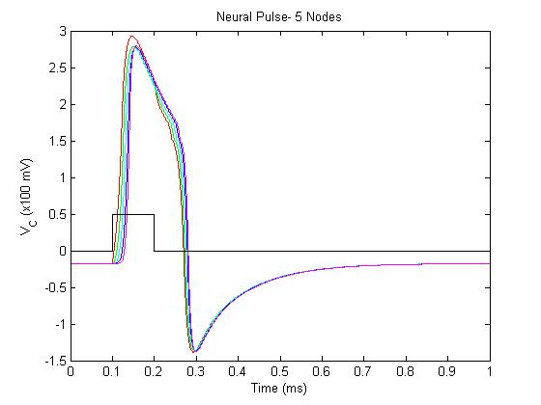
Results
C=.1 pF
Forcing current
Notes:
Susan: Using the multiple nodes algorithm, we modeled current transmission down a very short axon of 5 nodes. Most axons are between 20 and 300 nodes in length, but the properties should apply to a shorter axon. As you see in the picture, with a short pulse of injected current, the first node is excited, and then there is a slight lag between the excitation of each subsequent node. Furthermore, as seen in biology, there is a period of recovery, called the “refractory period” in which the cell cannot pass on another pulse. Biologically, this gives the ion channels time to restore equilibrium in the cell.

Slide 24
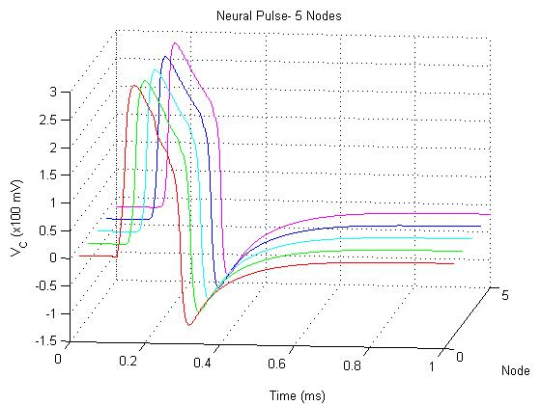
Results
C=.1 pF
Notes:
Susan: Here is the 3d representation of the pulse traveling down the axon- as you can see, it is just a traveling wave. After we noted that our model met expectations with 5 nodes, we decided to ramp it up to a more realistic number.

Slide 25
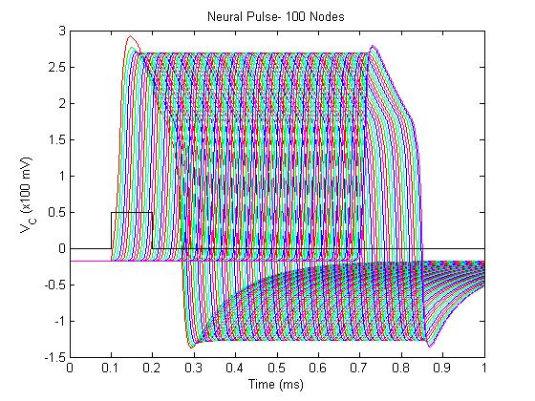
Results
C=.1 pF
Notes:
Susan: Here is the model for 100 Nodes. Since each node adds 4 differential equations to solve, producing this graph required solving 400 differential equations, which quickly will tax even the best computer. As you can see, with 100 nodes, the time lag becomes even more pronounced- about .6 ms, which doesn’t sound like a lot, but could be significant.

Slide 26
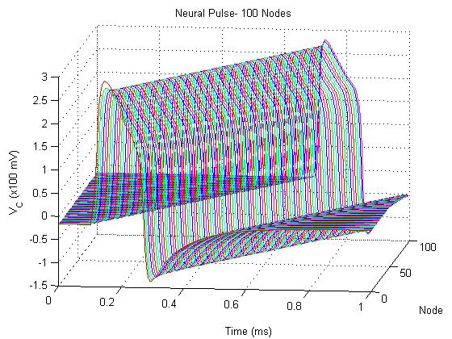
Results
C=.1 pF
Notes:
Susan: Here’s the 3d representation of a neural pulse traveling 100 nodes. Again, note the time lag between the time the pulse is transmitted to the first node and the time it reaches the final node. Biologically, we might guess that reducing the capacitance and increasing the myelination might increase the transmission speed of the pulse.

Slide 27
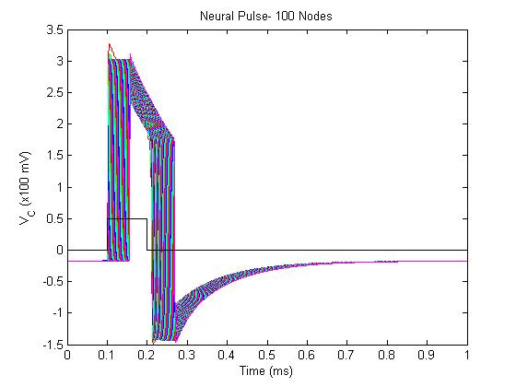
Results
C=.01 pF
Notes:
Susan: By reducing the capacitance by a factor of 10, you can see the difference that effective myelination makes to an axon. The pulse travels quickly, and while there is still a lag, the neuron has already been restored to a steady-state condition by the time the previous pulse would have reached the end of the axon.

Slide 28
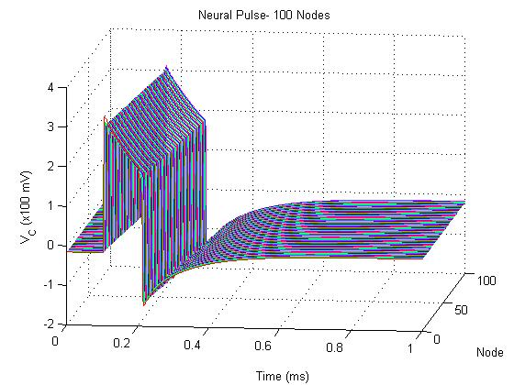
Results
C=.01 pF
Notes:
Susan: Additionally, the decreased capacitance produces a sharper pulse {this pulse peaks at about 300 mV whereas the previous one peaks at about 250 mV}, which would be more readily interpreted by the next cell- remember, all of these electrical pulses are transmitted by ions, and a very sharp increase in ion concentration would be much easier to interpret than a more gradual increase.
Myelination makes a great difference, biologically; but what happens when demyelination occurs and the capacitance rises?

Slide 29
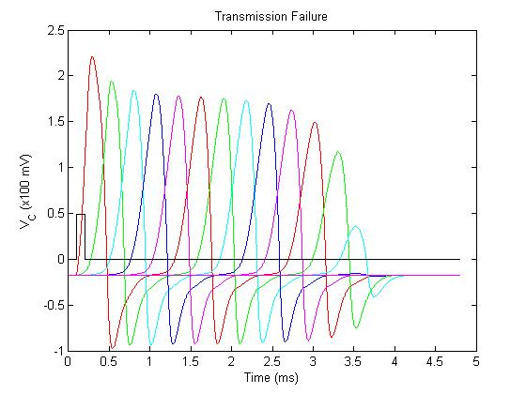
Results
C=.7 pF
Notes:
Susan: When the capacitance increases, the pulse does not transmit through the whole axon, which in this case is 20 nodes long. This prevents the signal from being transmitted to the next neuron, which can wreak havoc on the nervous system. Demyelination occurs in diseases such as Multiple Sclerosis, which can cause blindness, numbness, paralysis, and many other symptoms that can be traced back to pulses that are not being transmitted successfully or in a timely manner.

Slide 30
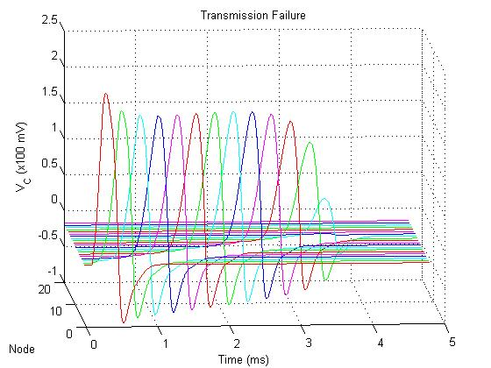
Results
C=.7 pF
Notes:
Susan: Here is the three-dimensional picture of the previous graph. Notice that the pulse vanishes around the 15th node.

Slide 31
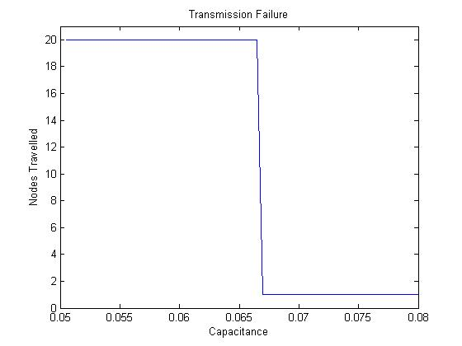
Transmission Failure
(x10 pF)
Notes:
Susan: We wondered at what point the capacitance prevented the pulse from traveling down the axon. By changing the capacitance, it became apparent that somewhere between .65 and .7 pF, the pulse failed to transmit along the axon.

Slide 32
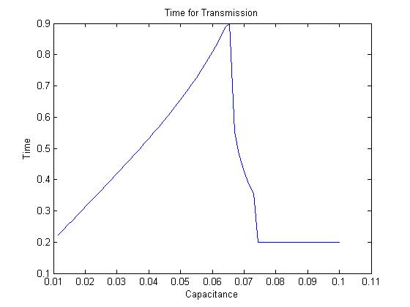
Transmission Failure
(ms)
(x10 pF)
Notes:
Susan: Furthermore, when we looked at the time it took for the pulse to be transmitted, an even clearer pattern emerged. Increased capacitance also increases the time that a pulse takes to travel down the axon. Furthermore, once the capacitance reaches the critical value that causes transmission failure <Click to show the line>, the time for transmission drops off. Biologically, it is important that these pulses are transmitted quickly- animals with slower nervous systems get eaten.

Slide 33
The Importance of Myelination
Notes:
Susan: We also decided to test our model’s demonstration of the importance of myelination. By modeling two axons, one myelinated and the other unmyelinated, but otherwise identical, we produced a similar result to the biological implications. The myelinated axon had 2 nodes- one at the beginning, and one in the middle, with insulation in between. The unmyelinated axon had 20 nodes, corresponding to a series of ion channels such as the ones shown in the biological representation. <Scroll through the next three slides.>

Slide 34
The Importance of Myelination

Slide 35
The Importance of Myelination

Slide 36
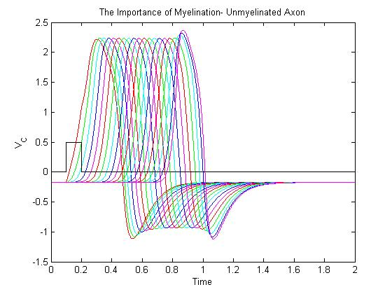
The Importance of Myelination
(x100 mV)
(ms)
Notes:
Susan: This is the unmyelinated axon. As you can see, the pulse travels down the unmyelinated axon and takes about .6 ms to reach the end. When the axon is myelinated, however,

Slide 37
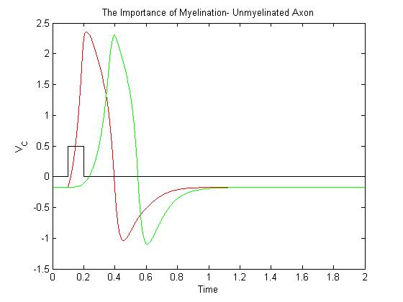
The Importance of Myelination
The Importance of Myelination- Myelinated Axon
(x100 mV)
(ms)
Notes:
Susan: the pulse takes about .2 ms to propagate down the axon.

Slide 38
Conclusions
Myelination matters! Myelination decreases capacitance and increases conductance velocity
If capacitance is too high, the pulse will not transmit
First model that shows a pulse that travels down the entire axon without dying out
Notes:
Noah: So, in conclusion, we deduce that the myelination does matter. By modeling the myelin with a low-capacitance capacitor, we see that the conductance velocity is increased. In particular, a high capacitance that corresponds to demyelination not only slows down the pulse, but also may make it fail to transmit. This appears to be the first model that shows the pulse traveling down the entire axon without dying out.

