Slide 1
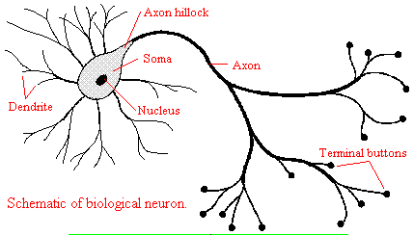
Circuit Models of Neurons
Bo Deng
University of Nebraska-Lincoln
Outlines:
Hodgkin-Huxley Model
Circuit Models
--- Elemental Characteristics
--- Ion Pump Dynamics
Examples of Dynamics
--- Bursting Spikes
--- Metastability and Plasticity
--- Chaos
--- Signal Transduction
AMS Regional Meeting at KU 03-30-12

Slide 2
Hodgkin-Huxley Model (1952)
Pros:
  The first system-wide model for excitable membranes.
  Mimics experimental data.
  Part of a Nobel Prize work.
  Fueled the theoretical neurosciences for the last
  60 years and counting.

Slide 3
Hodgkin-Huxley Model (1952)
Pros:
  The first system-wide model for excitable membranes.
  Mimics experimental data.
  Part of a Nobel Prize work.
  Fueled the theoretical neurosciences for the last
  60 years and counting.
Cons:
  It is not entirely mechanistic but phenomenological.
  Different, ad hoc, models can mimic the same data.
  It is ugly.
  Fueled the theoretical neurosciences for the last
  60 years and counting.

Slide 4
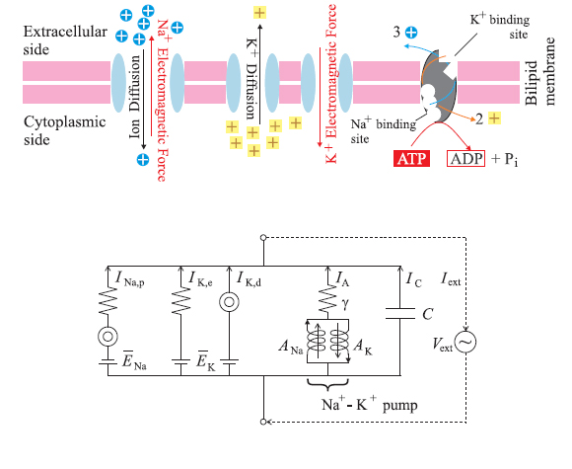
Hodgkin-Huxley Model --- Passive vs. Active Channels
Notes:
Noah: This circuit model represents one node of Ranvier, in that it contains the active and passive channels that allow for ion exchange. The Ion diffusion that occurs through the passive channels is represented by a diffuser <point to diffuser symbol> and the EMF {electro-motive force} is represented by a battery. Furthermore, ion exchange involves resistance, so there is a resistor included in each branch. In this model, the Sodium channels are together, and are represented by a serial branch, and the Potassium channels are parallel, represented by a parallel branch. This is the opposite configuration of the model Adrienne and Ty presented earlier [So they are going first? yes]. Furthermore, the active pump has been represented as 2 parallel inductors in series with a resistor, and the cell membrane is represented by a capacitor.

Slide 5
Hodgkin-Huxley Model
Notes:
Noah: This circuit model represents one node of Ranvier, in that it contains the active and passive channels that allow for ion exchange. The Ion diffusion that occurs through the passive channels is represented by a diffuser <point to diffuser symbol> and the EMF {electro-motive force} is represented by a battery. Furthermore, ion exchange involves resistance, so there is a resistor included in each branch. In this model, the Sodium channels are together, and are represented by a serial branch, and the Potassium channels are parallel, represented by a parallel branch. This is the opposite configuration of the model Adrienne and Ty presented earlier [So they are going first? yes]. Furthermore, the active pump has been represented as 2 parallel inductors in series with a resistor, and the cell membrane is represented by a capacitor.

Slide 6
Hodgkin-Huxley Model
Notes:
Noah: This circuit model represents one node of Ranvier, in that it contains the active and passive channels that allow for ion exchange. The Ion diffusion that occurs through the passive channels is represented by a diffuser <point to diffuser symbol> and the EMF {electro-motive force} is represented by a battery. Furthermore, ion exchange involves resistance, so there is a resistor included in each branch. In this model, the Sodium channels are together, and are represented by a serial branch, and the Potassium channels are parallel, represented by a parallel branch. This is the opposite configuration of the model Adrienne and Ty presented earlier [So they are going first? yes]. Furthermore, the active pump has been represented as 2 parallel inductors in series with a resistor, and the cell membrane is represented by a capacitor.

Slide 7
Hodgkin-Huxley Model
Notes:
Noah: This circuit model represents one node of Ranvier, in that it contains the active and passive channels that allow for ion exchange. The Ion diffusion that occurs through the passive channels is represented by a diffuser <point to diffuser symbol> and the EMF {electro-motive force} is represented by a battery. Furthermore, ion exchange involves resistance, so there is a resistor included in each branch. In this model, the Sodium channels are together, and are represented by a serial branch, and the Potassium channels are parallel, represented by a parallel branch. This is the opposite configuration of the model Adrienne and Ty presented earlier [So they are going first? yes]. Furthermore, the active pump has been represented as 2 parallel inductors in series with a resistor, and the cell membrane is represented by a capacitor.

Slide 8
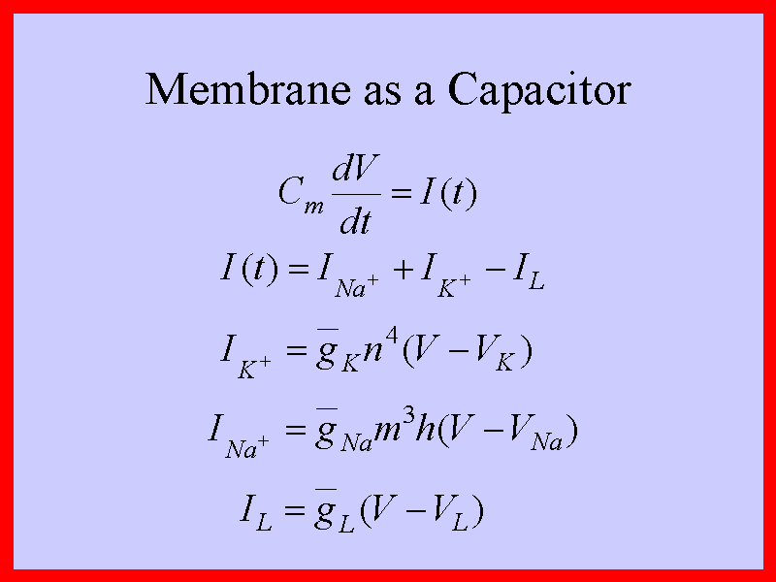
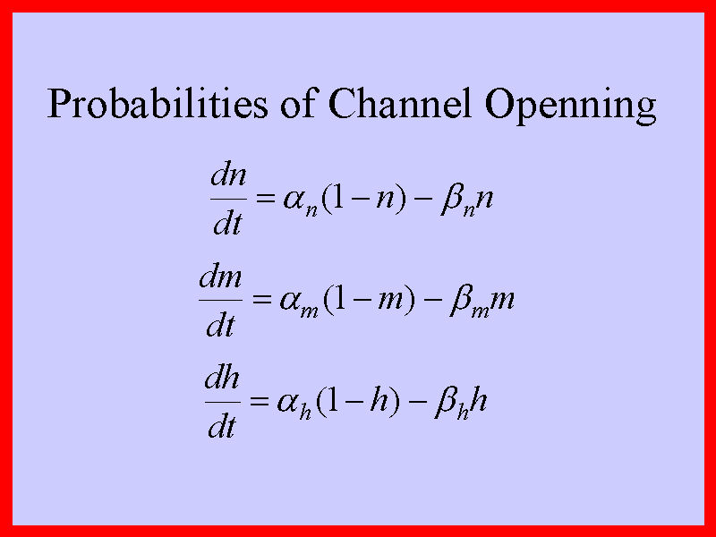
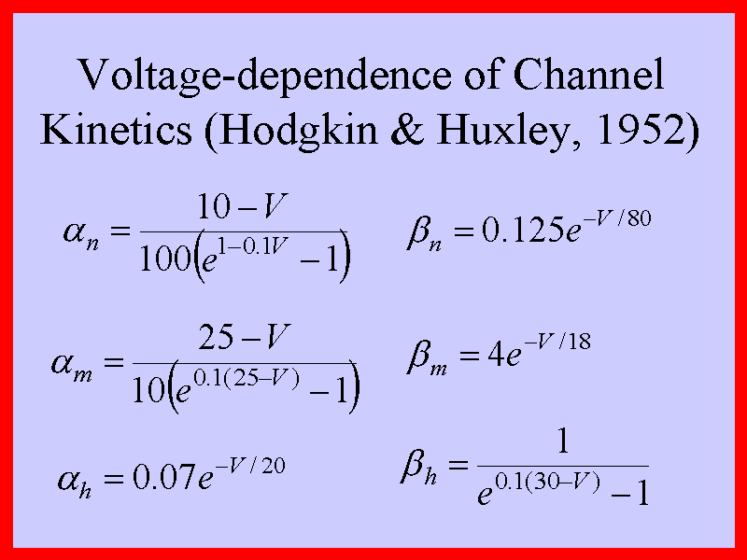
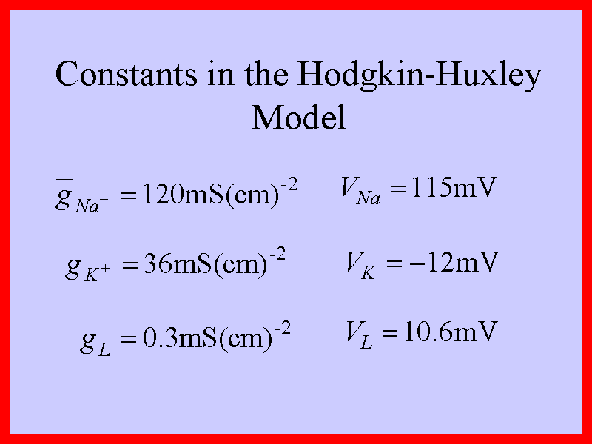
C
-I (t)
The only mechanistic part
( by Kirchhoff’s Current Law)
+

Slide 9
Hodgkin-Huxley Model --- A Useful Clue
Notes:
Noah: This circuit model represents one node of Ranvier, in that it contains the active and passive channels that allow for ion exchange. The Ion diffusion that occurs through the passive channels is represented by a diffuser <point to diffuser symbol> and the EMF {electro-motive force} is represented by a battery. Furthermore, ion exchange involves resistance, so there is a resistor included in each branch. In this model, the Sodium channels are together, and are represented by a serial branch, and the Potassium channels are parallel, represented by a parallel branch. This is the opposite configuration of the model Adrienne and Ty presented earlier [So they are going first? yes]. Furthermore, the active pump has been represented as 2 parallel inductors in series with a resistor, and the cell membrane is represented by a capacitor.

Slide 10
H-H Type Models for Excitable Membranes
Morris, C. and H. Lecar,
Voltage oscillations in the barnacle giant muscle fiber,
Biophysical J., 35(1981), pp.193--213.
Hindmarsh, J.L. and R.M. Rose,
A model of neuronal bursting using three coupled first order differential
equations,
Proc. R. Soc. Lond. B. 221(1984), pp.87--102.
Chay, T.R., Y.S. Fan, and Y.S. Lee
Bursting, spiking, chaos, fractals, and universality in biological
rhythms, Int. J. Bif. & Chaos, 5(1995), pp.595--635.

Slide 11
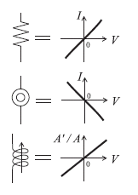
Our Circuit Models
Elemental Characteristics -- Resistor
Notes:
Noah: This circuit model represents one node of Ranvier, in that it contains the active and passive channels that allow for ion exchange. The Ion diffusion that occurs through the passive channels is represented by a diffuser <point to diffuser symbol> and the EMF {electro-motive force} is represented by a battery. Furthermore, ion exchange involves resistance, so there is a resistor included in each branch. In this model, the Sodium channels are together, and are represented by a serial branch, and the Potassium channels are parallel, represented by a parallel branch. This is the opposite configuration of the model Adrienne and Ty presented earlier [So they are going first? yes]. Furthermore, the active pump has been represented as 2 parallel inductors in series with a resistor, and the cell membrane is represented by a capacitor.

Slide 12
Our Circuit Models
Elemental Characteristics -- Diffusor
Notes:
Noah: This circuit model represents one node of Ranvier, in that it contains the active and passive channels that allow for ion exchange. The Ion diffusion that occurs through the passive channels is represented by a diffuser <point to diffuser symbol> and the EMF {electro-motive force} is represented by a battery. Furthermore, ion exchange involves resistance, so there is a resistor included in each branch. In this model, the Sodium channels are together, and are represented by a serial branch, and the Potassium channels are parallel, represented by a parallel branch. This is the opposite configuration of the model Adrienne and Ty presented earlier [So they are going first? yes]. Furthermore, the active pump has been represented as 2 parallel inductors in series with a resistor, and the cell membrane is represented by a capacitor.

Slide 13
Our Circuit Models
Elemental Characteristics -- Ion Pump
Notes:
Noah: This circuit model represents one node of Ranvier, in that it contains the active and passive channels that allow for ion exchange. The Ion diffusion that occurs through the passive channels is represented by a diffuser <point to diffuser symbol> and the EMF {electro-motive force} is represented by a battery. Furthermore, ion exchange involves resistance, so there is a resistor included in each branch. In this model, the Sodium channels are together, and are represented by a serial branch, and the Potassium channels are parallel, represented by a parallel branch. This is the opposite configuration of the model Adrienne and Ty presented earlier [So they are going first? yes]. Furthermore, the active pump has been represented as 2 parallel inductors in series with a resistor, and the cell membrane is represented by a capacitor.

Slide 14
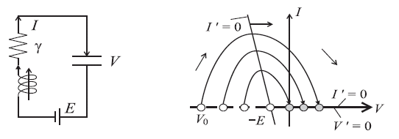

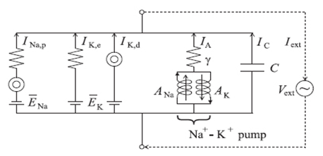
Dynamics of Ion Pump as Battery Charger

Slide 15
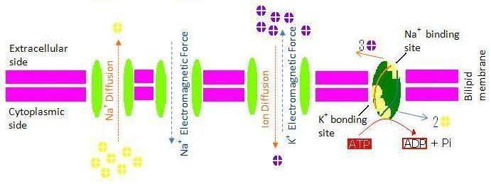
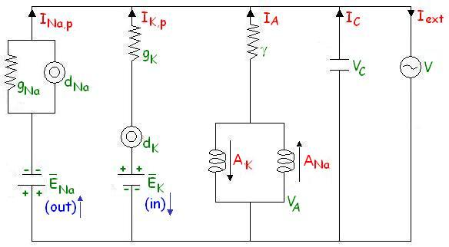

Slide 16
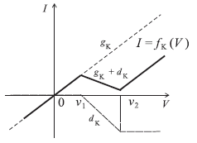
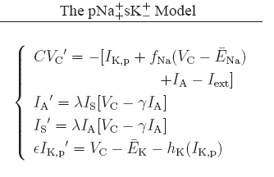
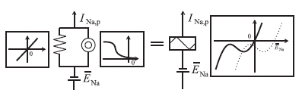
Equivalent IV-Characteristics
--- for parallel channels
Passive sodium current can be explicitly expressed as

Slide 17
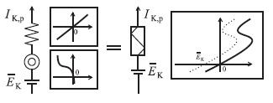

Equivalent IV-Characteristics
--- for serial channels
Passive potassium current can be implicitly expressed as
A standard circuit technique to represent the hysteresis is to turn it into a singularly perturbed equation
0

Slide 18




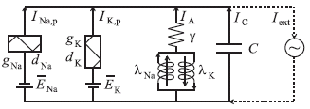
Equations for Ion Pump
By Ion Pump Characteristics
with substitution and assumption
to get

Slide 19
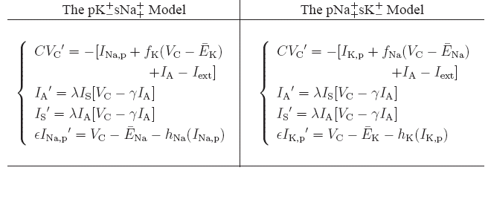
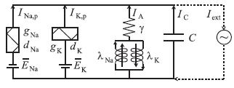
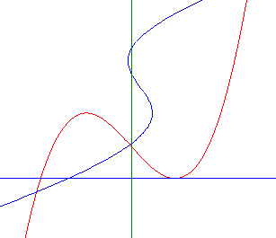
V_{K} = h_{K} (I_{K,p})
I _{Na} = f_{Na} (V_{C} – E_{Na})

Slide 21
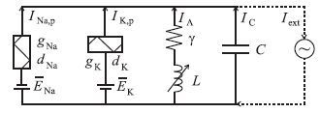
Examples of Dynamics
--- Bursting Spikes
--- Chaotic Shilnikov Attractor
--- Metastability & Plasticity
--- Signal Transduction
Geometric Method of Singular Perturbation
Small Parameters:
0 < ε << 1 with ideal
hysteresis at ε = 0
both C and λ have
independent time scales

Slide 22
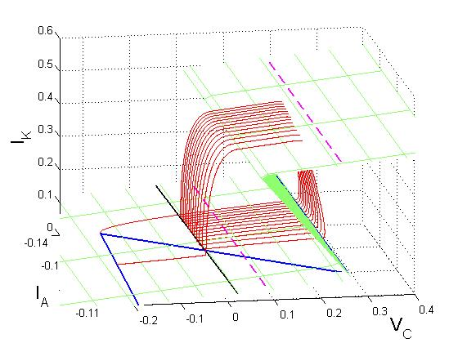
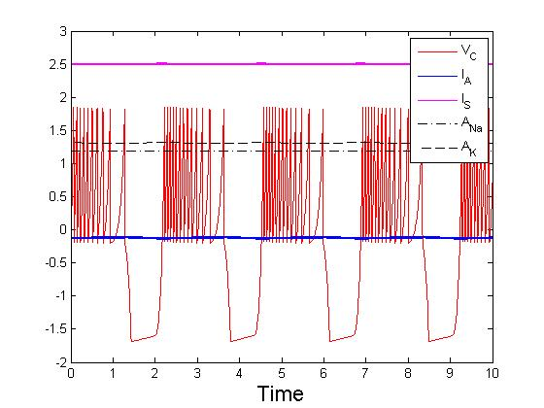
Bursting Spikes
C = 0.005

Slide 23
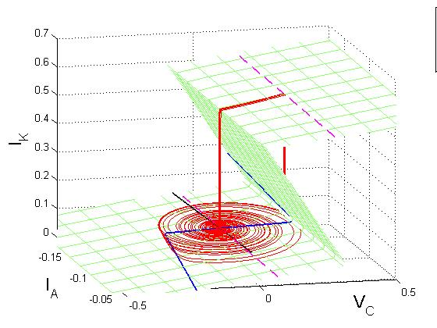
Neural Chaos
g_{Na} = 1
d_{Na} = - 1.22
v₁ = - 0.8
v₂ = - 0.1
E_{Na} = 0.6
C = 0.5
= 0.05
γ = 0.18
= 0.0005
I_{in} = 0
C = 0.005
g_{K} = 0.1515
d_{K} = -0.1382
i₁ = 0.14
i₂ = 0.52
E_{K} = - 0.7
C = 0.5

Slide 24
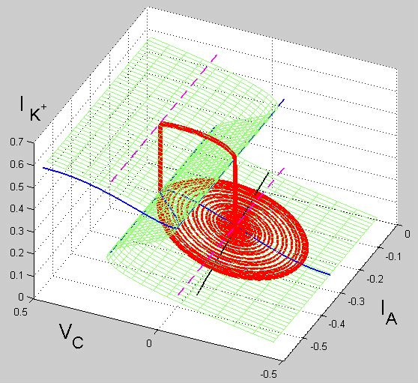
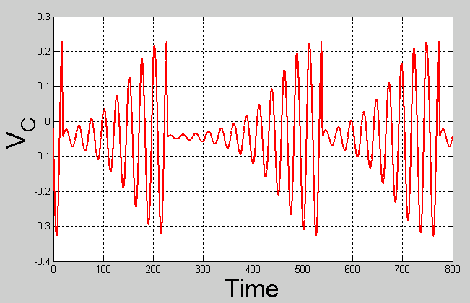
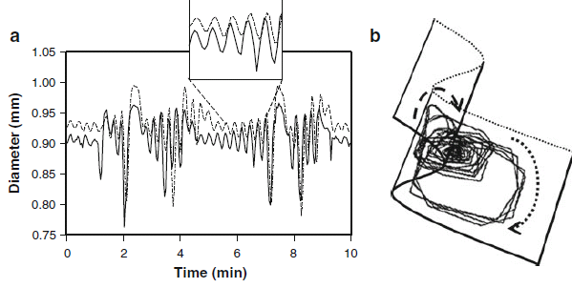
Griffith et. al. 2009

Slide 25
Metastability and Plasticity
Terminology:
A transient state which behaves like a steady state is
referred to as metastable.
A system which can switch from one metastable state
to another metastable state is referred to as plastic.
Notes:
Susan: Here is the three-dimensional picture of the previous graph. Notice that the pulse vanishes around the 15th node.

Slide 26
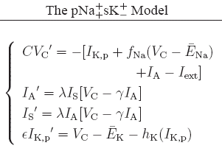
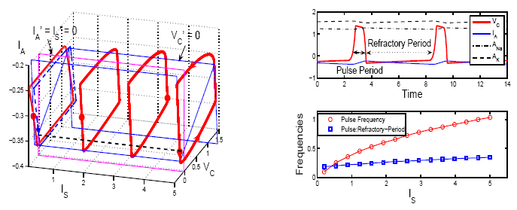
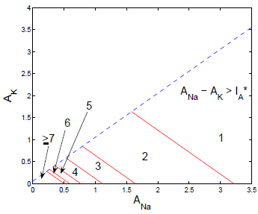
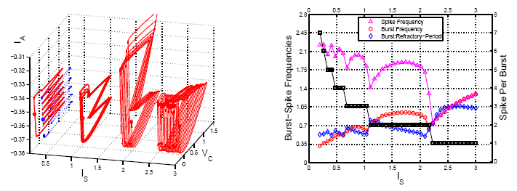
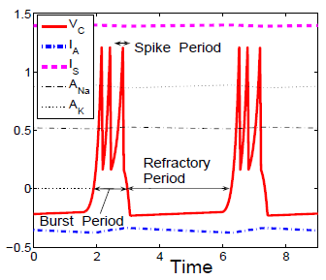
Metastability and Plasticity
Notes:
Susan: Here is the three-dimensional picture of the previous graph. Notice that the pulse vanishes around the 15th node.

Slide 27
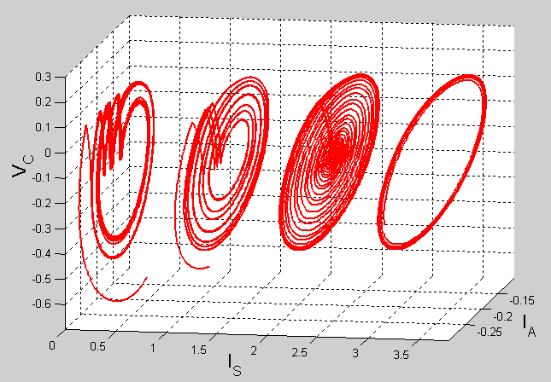
Metastability and Plasticity

Slide 28
Metastability and Plasticity
All plastic and metastable states are lost with only one
ion pump. I.e. when A_{Na} = 0 or A_{K} = 0 we have either
I_{s} = I_{A} or I_{s} = -I_{A} and the two ion pump equations are
reduced to one equation, leaving the phase space one
dimension short for the coexistence of multispike burst
or periodic orbit attractors.
With two ion pumps, all neuronal dynamics run on
transients, which represents a paradigm shift from basing
neuronal dynamics on asymptotic properties, which can
be a pathological trap for normal physiological functions.

Slide 29


Slide 30
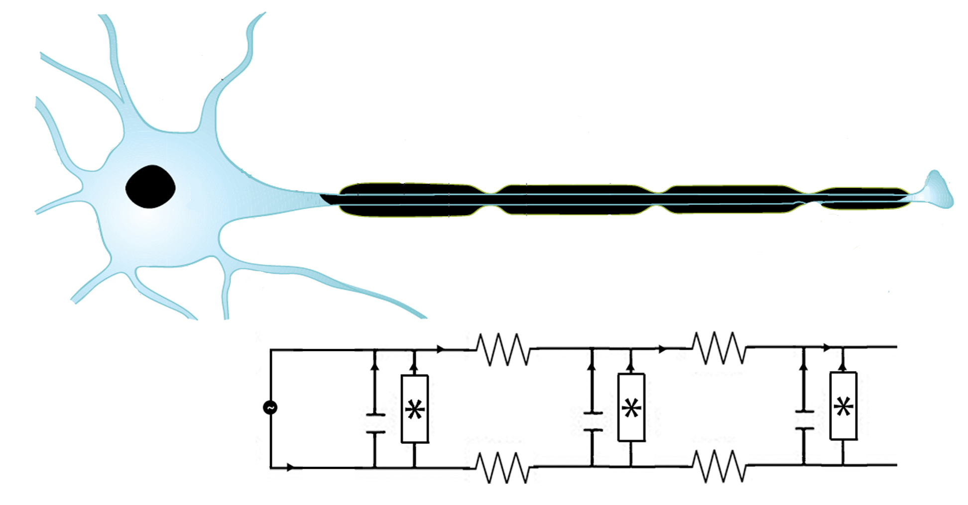
Saltatory Conduction along Myelinated Axon with Multiple Nodes
Inside the cell
Outside the cell
Joint work with undergraduate and graduate students: Suzan Coons, Noah Weis, Adrienne Amador, Tyler Takeshita, Brittney Hinds, and Kaelly Simpson
Notes:
Noah: By linking multiple nodes together with resistors in between, we can represent an axon. The external current is injected into the circuit by the cell body <Point to it>, and then passes through alternating nodes <Point to one> and myelinated segments <Point to one>. Each node is then represented by the equations previously derived.

Slide 31
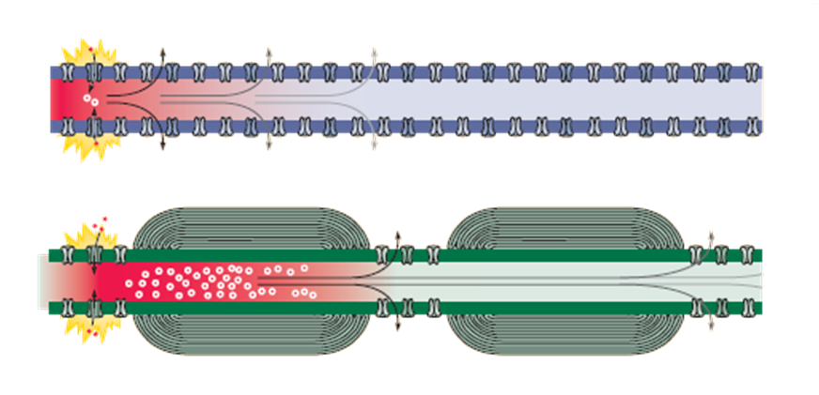
Signal Transduction along Axons
Neuroscience: 3ed
Notes:
Susan: Myelination is very important to the transmission of neural impulses. It increases transmission speed by insulating the electrical impulse from leaks. Electrically, it reduces the capacitance of the membrane, which reduces the amount of charge that can be stored in these regions. Therefore less current can leak. <Cycle through the next three slides.>

Slide 32
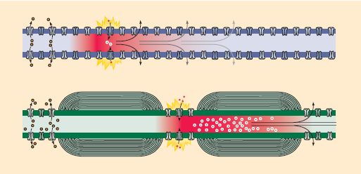
Neuroscience: 3ed

Slide 33
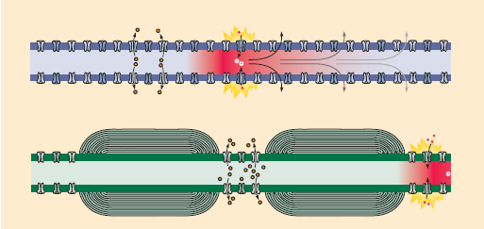
Neuroscience: 3ed
Notes:
Susan: The fewer ion channels available, as in a myelinated axon, the more quickly the pulse can move, because ion exchange takes a certain amount of time.

Slide 34
Circuit Equations of Individual Node
Notes:
Noah: Let’s review our four-dimensional system of equations. This equation is for a single node of Ranvier. <Pause for a second or two.> We can use this equation to generalize to the multiple node situation of an axon.

Slide 35
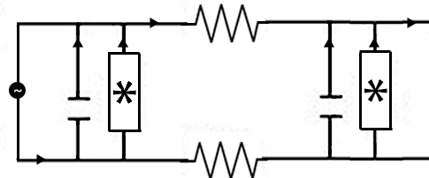
Coupled Equations for Neighboring Nodes
Couple the nodes by adding a linear resistor between them
Current between the nodes
Notes:
Noah: We model the coupling of the nodes by adding linear resistors between the nodes. Using the current law, we can add a coupling current term to the end of the top equation. The Kirchhoff loop to use here goes from the first capacitor to the top resistor to the second capacitor to the bottom resistor. Calling this current I_out, we can solve for I_out and we obtain the coupling expression right here <Point to the top coupling term>. However, we add this same term with the opposite sign for the second node, as it is the same current but is incoming <Click and/or point>.

Slide 36
The General Case for N Nodes
This is the general equation for the nth node
In and out currents are derived in a similar manner:
Notes:
Noah: Using recursion, it is straightforward to derive a general expression for a system with N nodes. It will be a system with 4N equations, but each set of four equations is nearly identical. The only difference between each nodal equation are the ingoing and outgoing currents of the first equation. Everything else is identical for each node (aside from the superscript). In particular, we can derive the following equations to give the incoming and outgoing currents for each node <Point to the bottom set>.

Slide 37
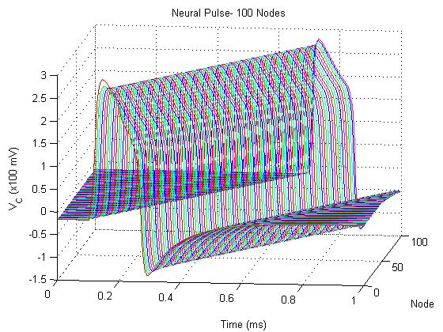
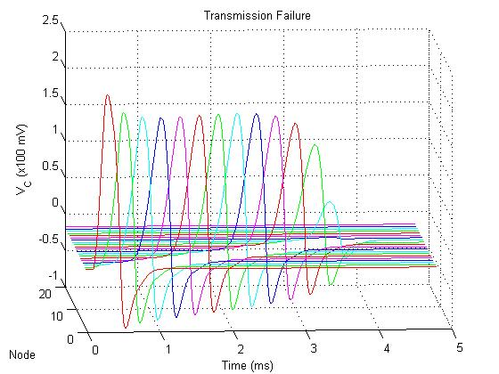
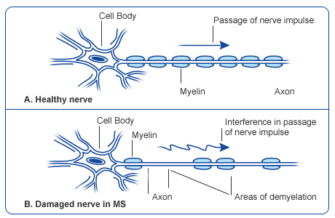
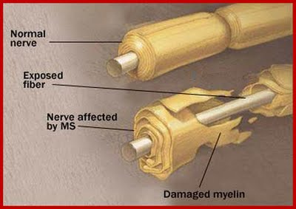
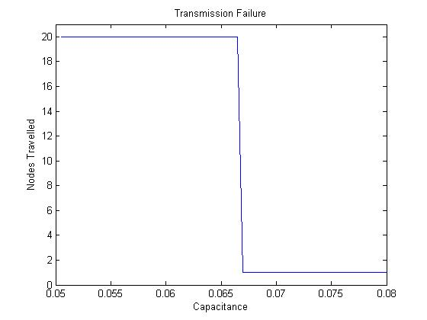
C=.1 pF
C=.7 pF
(x10 pF)
Notes:
Susan: Here’s the 3d representation of a neural pulse traveling 100 nodes. Again, note the time lag between the time the pulse is transmitted to the first node and the time it reaches the final node. Biologically, we might guess that reducing the capacitance and increasing the myelination might increase the transmission speed of the pulse.

Slide 38
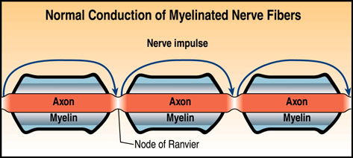
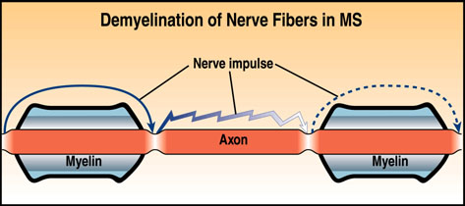
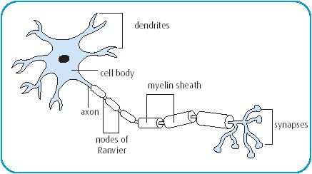
C=.7 pF
Notes:
Susan: Here’s the 3d representation of a neural pulse traveling 100 nodes. Again, note the time lag between the time the pulse is transmitted to the first node and the time it reaches the final node. Biologically, we might guess that reducing the capacitance and increasing the myelination might increase the transmission speed of the pulse.

Slide 39
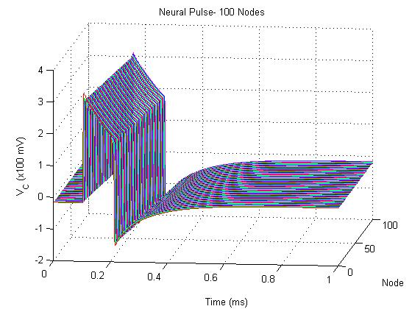
Transmission Speed
C=.1 pF
C=.01 pF
Notes:
Susan: We wondered at what point the capacitance prevented the pulse from traveling down the axon. By changing the capacitance, it became apparent that somewhere between .65 and .7 pF, the pulse failed to transmit along the axon.

Slide 40
Closing Remarks:
The circuit models can be further improved by dropping the
serial connectivity assumption of the passive electrical
and diffusive currents.
Existence of chaotic attractors can be rigorously proved,
including junction-fold, Shilnikov, and canard attractors.
Can be easily fitted to experimental data.
Can be used to build real circuits.
Kandel, E.R., J.H. Schwartz, and T.M. Jessell
Principles of Neural Science, 3rd ed., Elsevier, 1991.
Zigmond, M.J., F.E. Bloom, S.C. Landis, J.L. Roberts, and L.R. Squire
Fundamental Neuroscience, Academic Press, 1999.
References:
[BD] A Conceptual Circuit Model of Neuron, Journal of Integrative Neuroscience, 8(2009), pp.255-297.
Metastability and Plasticity of Conceptual Circuit Models of Neurons, Journal of Integrative Neuroscience, 9(2010), pp.31-47.

Slide 42
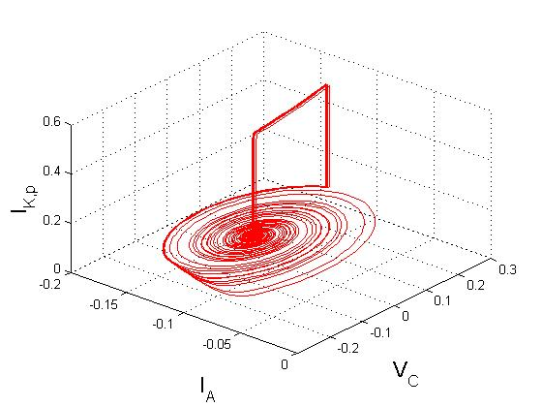
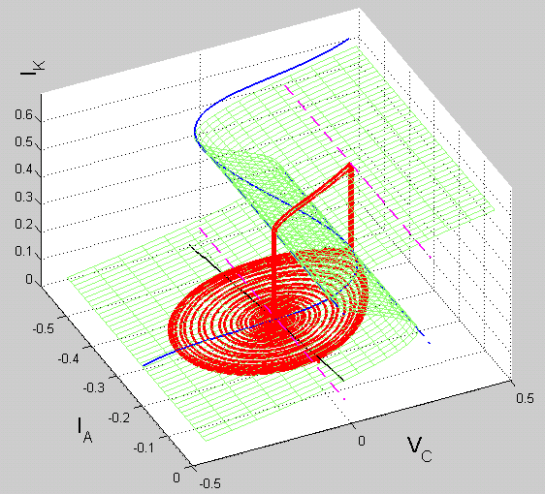

Slide 43
