Slide 1
How to Prove Shilnikov Chaos for Chemostat Model
Bo Deng
University of Nebraska-Lincoln
SHNU 19-12-2016

Slide 2
Outline:
  Shilnikov’s Saddle-Focus Homoclinic Orbit
  Singularly Perturbed Food-Chains
  Chemostat Model
  Numerical Proof for Chemostat Chaos

Slide 3
Brief History of Shilnikov’s Homoclinic Orbit Chaos:
  Smale discovered the horseshoe map in 1967
  Shilnikov proved the horseshoe dynamics for ODE having a saddle-focus homoclinic orbit in 1967 immediately after Smale’s work
  Rössler outlined a singular perturbation construction for Shilnikov’s saddle-focus homoclinic orbit in 1976
  Deng obtained a more complete result in 1993, and proved the existence of a singular SSFH orbit for a food-chain model in 2002

Slide 4
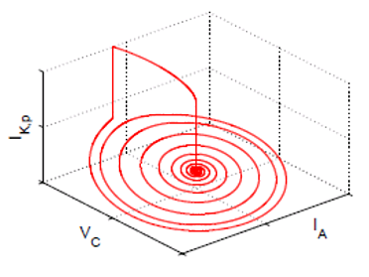
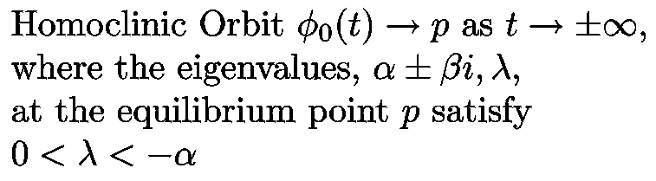
Shilnikov’s saddle-focus homoclinic orbit
Shilnikov’s saddle-focus homoclinic orbit of vector fields
μ ± i β , λ ,
0 < μ < −λ , β > 0

Slide 5
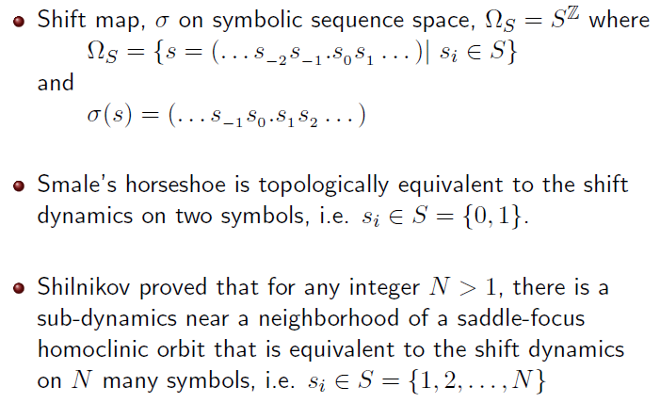

Slide 6
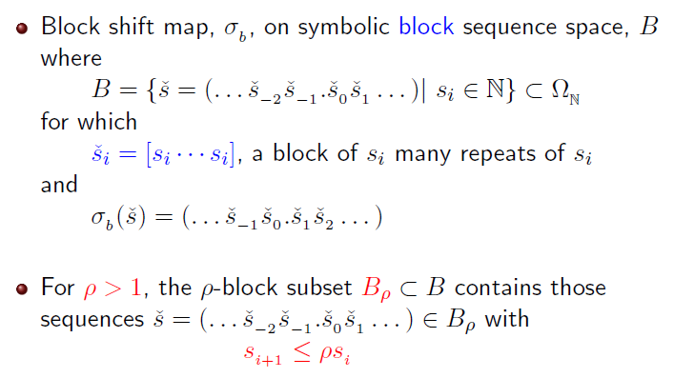

Slide 7
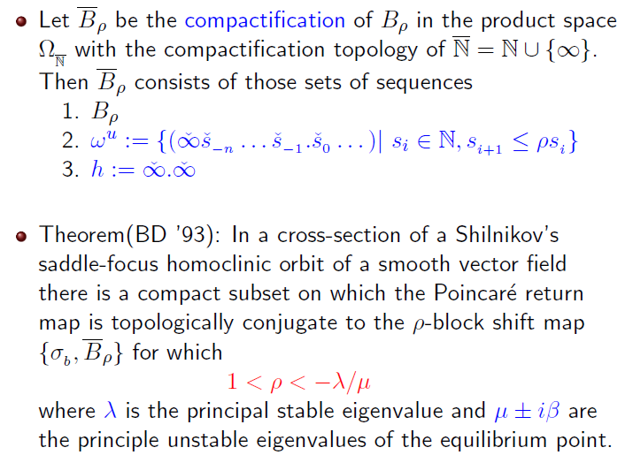

Slide 8
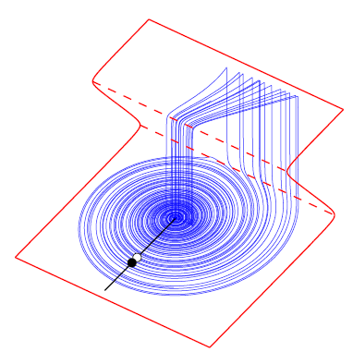
Examples of Shilnikov’s Chaos and Foodweb Chaos
Constructed by Rösslor’s singular perturbation method (BD ’94)
Singlular saddle-focus homoclinic orbit is automatically Shilnikov

Slide 9

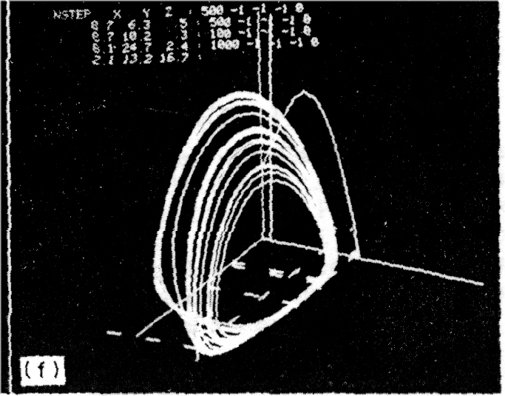
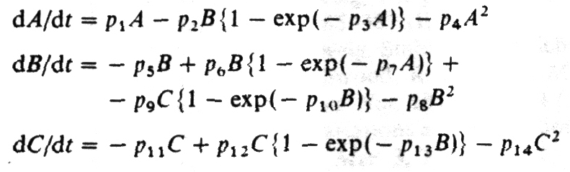
First Food Chain Model Chaos
P.Hogeweg & B. Hesper,
`Interactive Instruction on
Population Interactions’
Comput. Biol. Med.
1977~1978

Slide 10
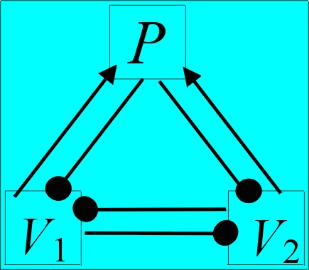
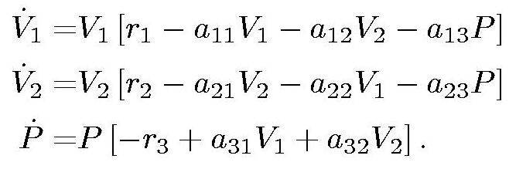
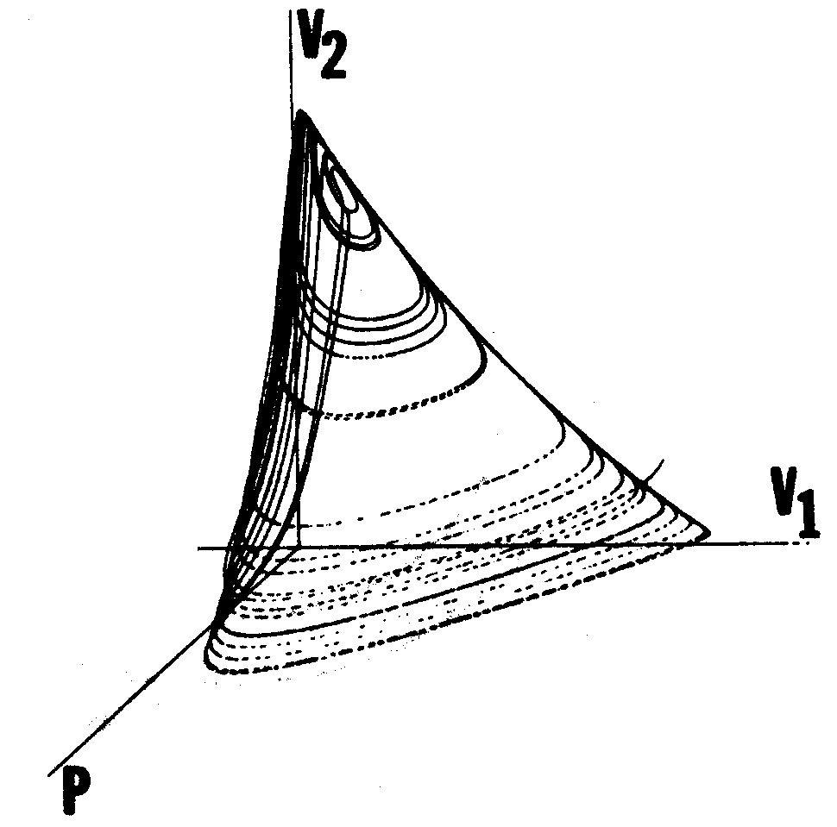
First Food Web Model Chaos
M.E. Gilpin
`Spiral Chaos in Predator-Prey
Model’
Amer. Nat.
1977~1979

Slide 11
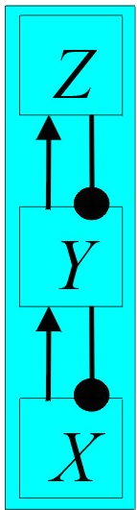
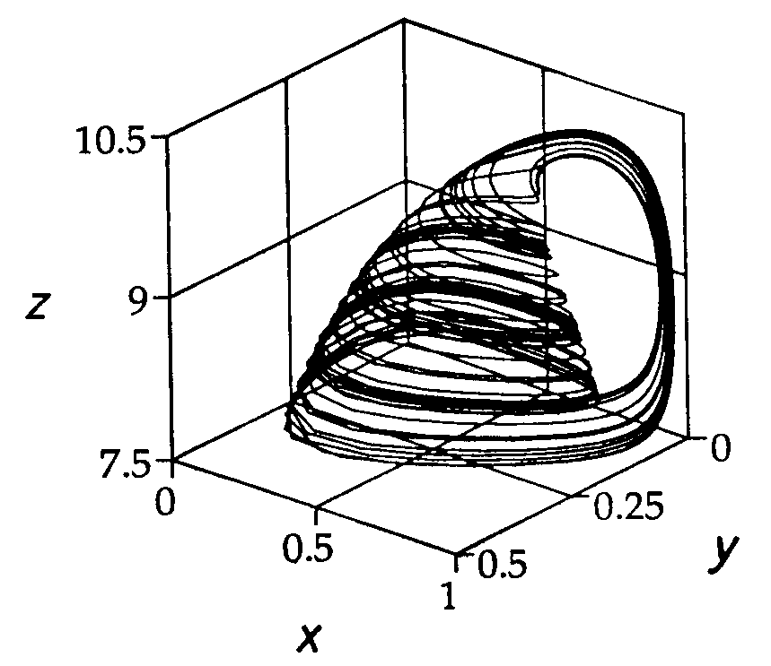
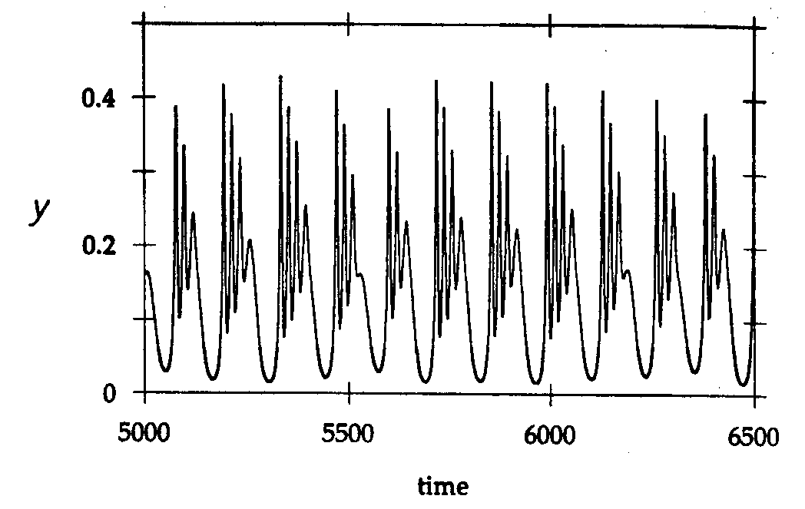
Tea-Cup (Model) Attractor
A. Hastings & T. Powell
Ecology
1991

Slide 12
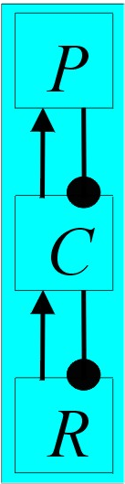
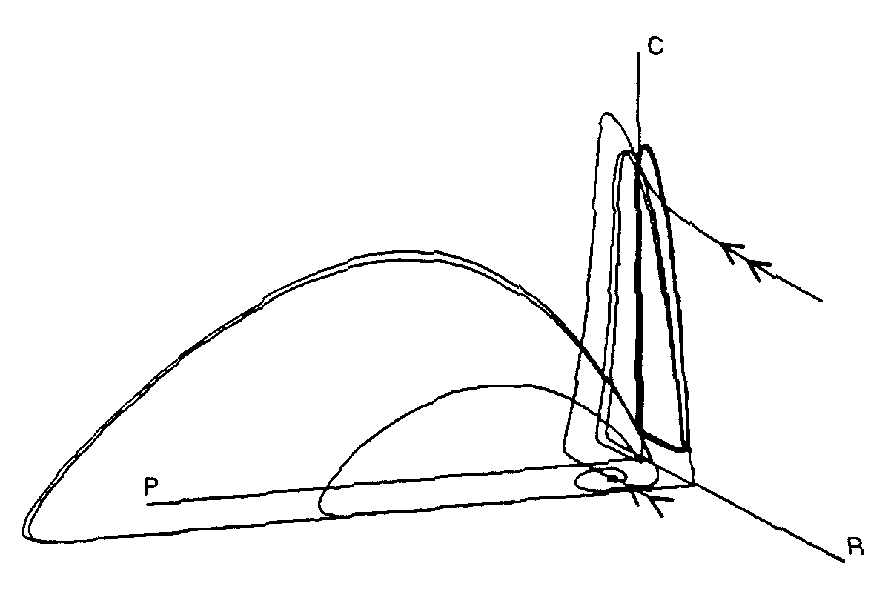
Shilnikov Attractor
K. McCann & P. Yodzis
Theor. Pop. Bio.
1995
p

Slide 13
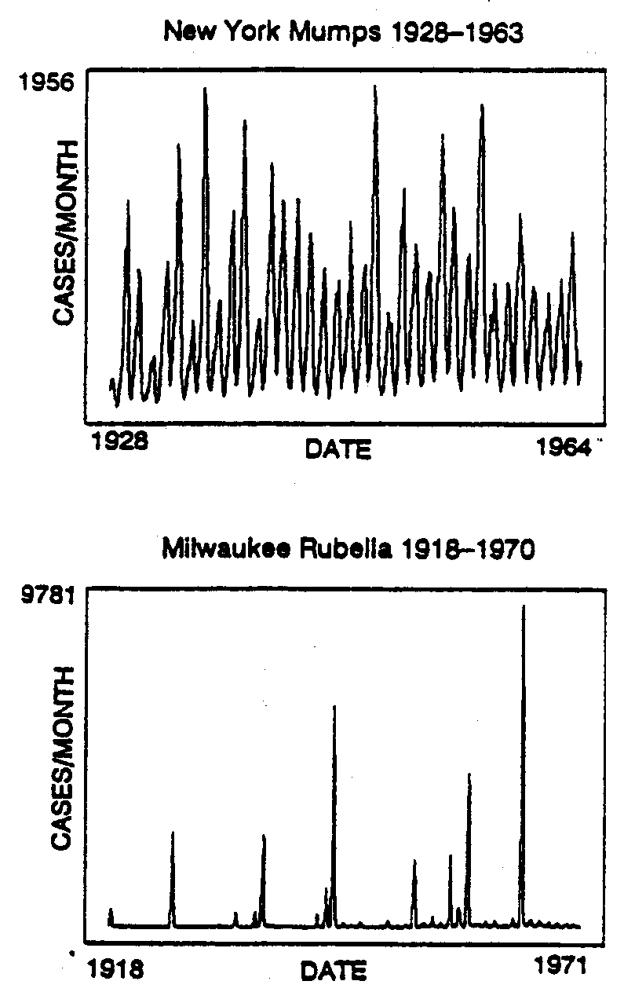
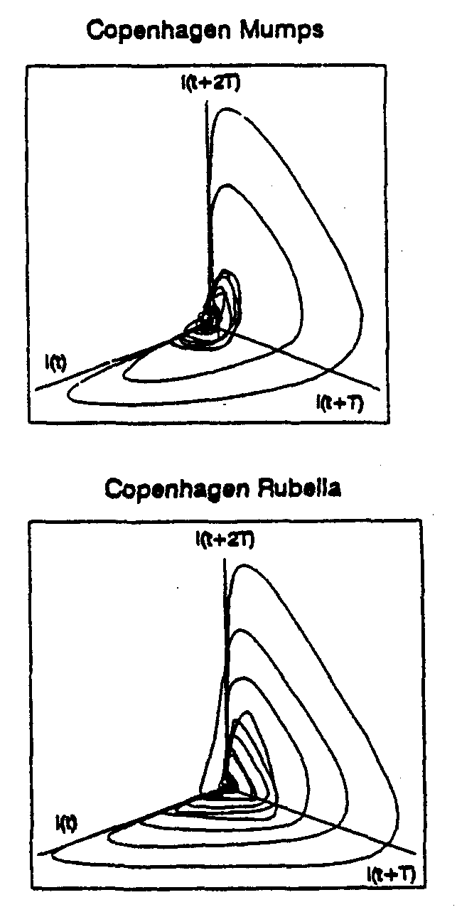
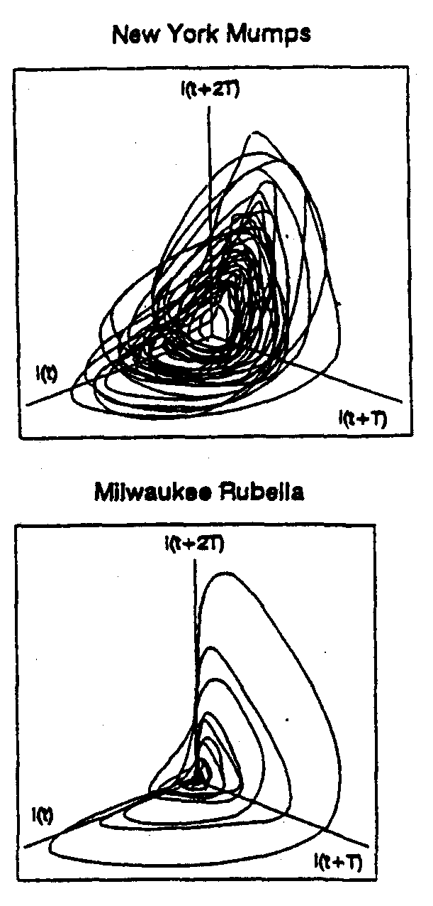
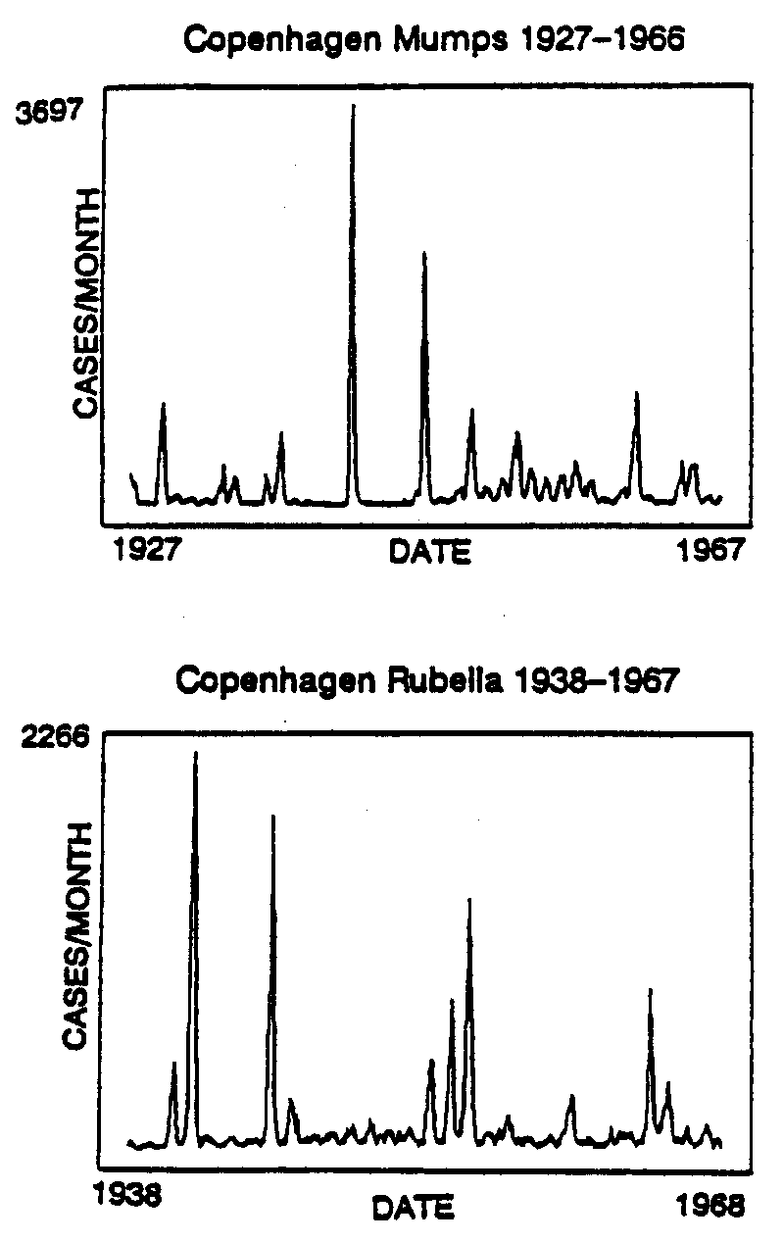
Other Examples -- Childhood Epidemics
SEIR (Susceptible, Exposed, Infectious, Recovered) Dynamics
W.M. Schaffer, L.F. Olsen, G.L. Truty, S.L. Fulmer
1985, 1993

Slide 14
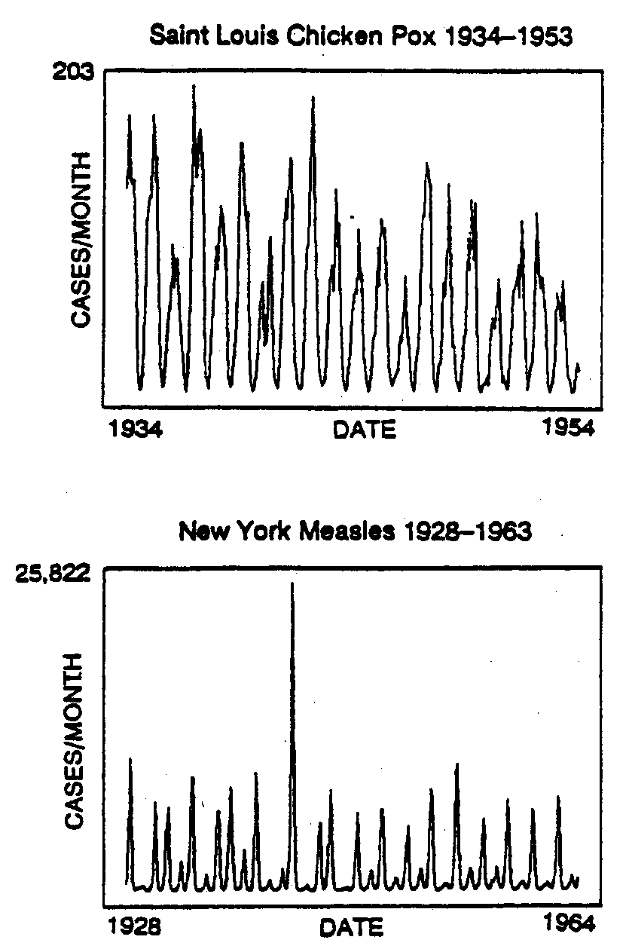
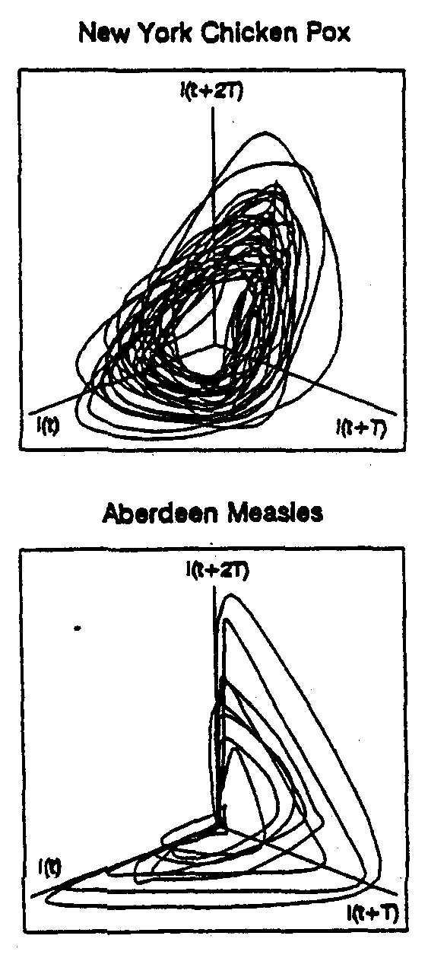
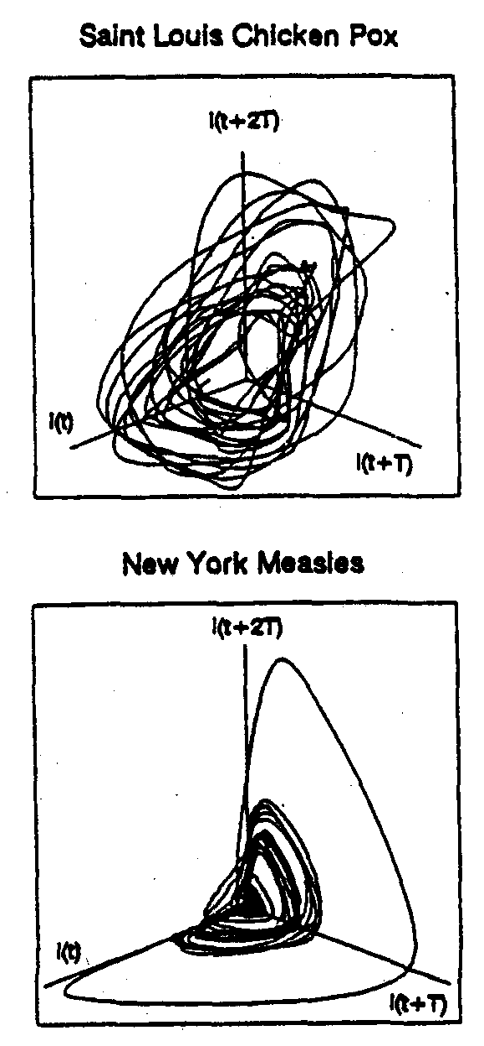
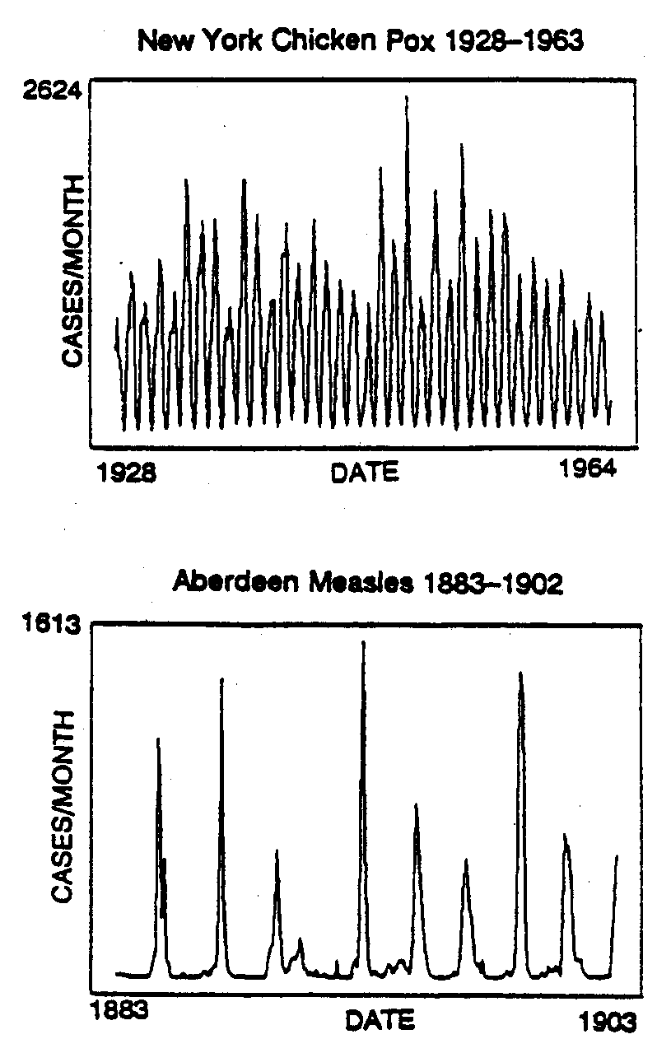
... More Childhood Epidemics
W.M. Schaffer, L.F. Olsen, G.L. Truty, S.L. Fulmer
1985, 1993

Slide 15


Lesson from Food-Chain Chaos
Predator-Prey:
Food Chains:
Dimensionless Model:

Slide 16
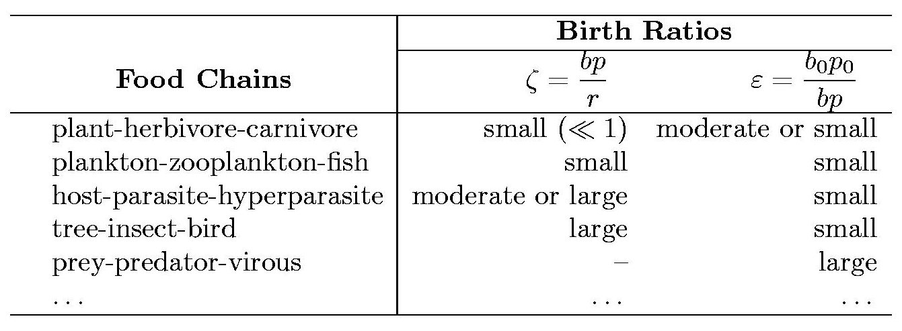

Classification By Trophic Time Scales
Dimensionless Model:
Singularly perturbed Models if 0 < ε << 1

Slide 17


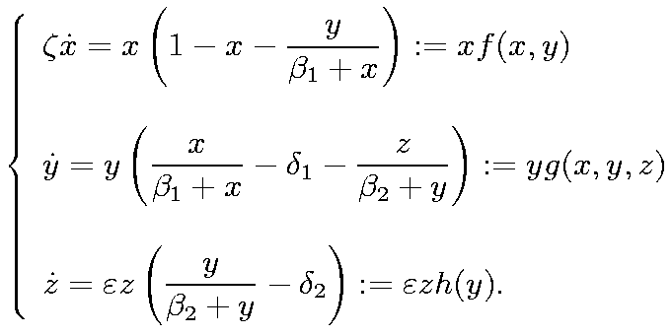
Fast
2-times scale
singularly perturbed
system.
Slow
Slower
3-times scale
singularly perturbed
system.

Slide 18
Singular Perturbations
Geometric Singular Perturbation
y
z
0
x

Slide 19
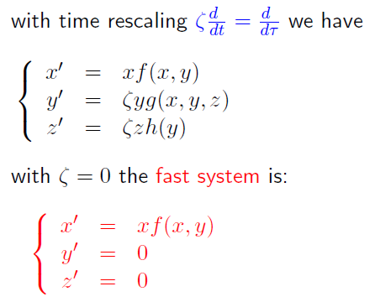

Singular Perturbations
Fast & Slow Dynamics
x = 0
y
z
0
dx/dt = 0
x

Slide 20
Singular Perturbations
Fast & Slow Dynamics
x = 0
y
z
0
dx/dt = 0
x

Slide 21
Singular Perturbations
Fast & Slow Dynamics
Transcritical Point
x = 0
y
z
0
dx/dt = 0
x

Slide 22
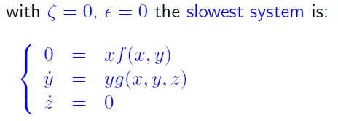
Singular Perturbations
Fast & Slow Dynamics
x = 0
y
z
PDLS
0
dx/dt = 0
R_{PDLS}
x

Slide 23
Singular Perturbations
Fast & Slow Dynamics
x = 0
y
z
dy/dt = 0
0
dx/dt = 0
x
y = 0

Slide 24
Singular Perturbations
Fast & Slow Dynamics
y
z
dy/dt = 0
0
dx/dt = 0
x

Slide 25
Singular Perturbations
Fast & Slow Dynamics
y
z
dy/dt = 0
0
dx/dt = 0
x

Slide 26
Singular Perturbations
Fast & Slow Dynamics
dy/dt = 0
y
z
dz/dt = 0
0
dx/dt = 0
x

Slide 27
Singular Perturbations
Fast & Slow Dynamics
dy/dt = 0
y
z
dz/dt = 0
p
0
dx/dt = 0
x

Slide 28
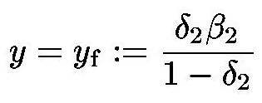
Singular Perturbations
Fast & Slow Dynamics
dy/dt = 0
y
z
γ
dz/dt = 0
p
0
dx/dt = 0
x
R_{PDLS}

Slide 29
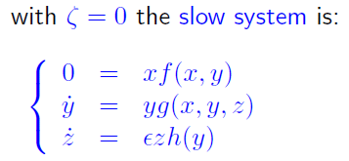
Singular Perturbations
Fast & Slow Dynamics
0 < ζ << 1
0
y
ζ ~ 1
γ
p
y_{f}
R_{PDLS}
z

Slide 30
Singular Perturbations
Singular Saddle-Focus Homoclinic Orbit
dy/dt = 0
y
z
ζ ~ 1
PDLS
dz/dt = 0
0
R_{PDLS}
dx/dt = 0
x

Slide 31
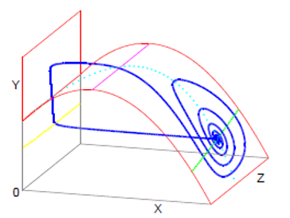
Theorem (BD and Hinds, ’02): There exists a set of parameters so that
for ε = 0 the food-chain model has a singular Shilnikov’s saddle-focus
homoclinic orbit and it persists for small 0 < ε << 1

Slide 32
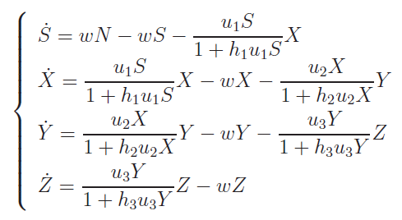
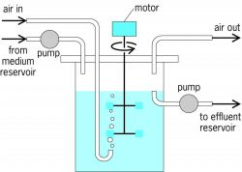
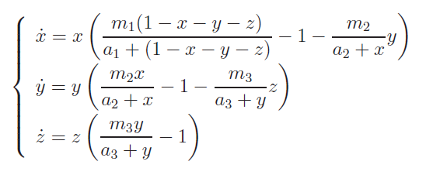
Chemostat Model
C
Chemostat Schematics Diagram
well-mixed culture
Joint work in progress with Professor S. Hsu and Professor M. Han

Slide 33
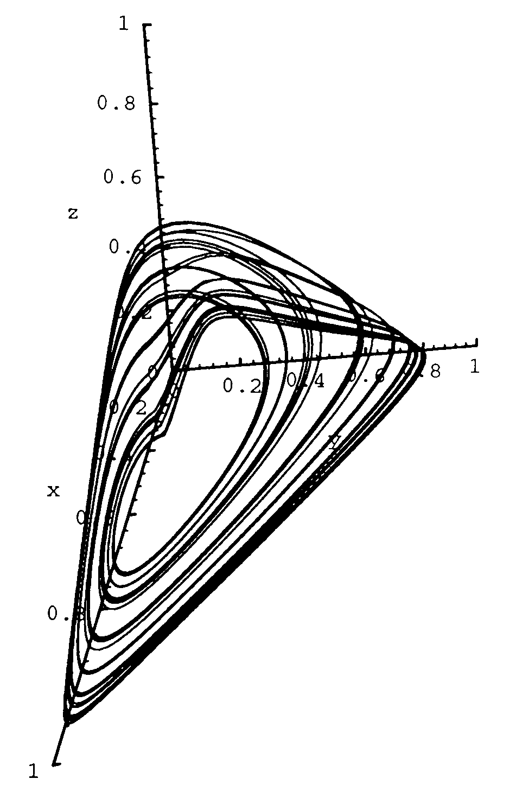
Chemostat Chaos?
H. Smith & P. Waltman
Cmbridge Studies in Math. Biol.
1994
… How to prove it?

Slide 34
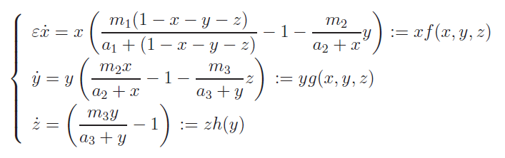

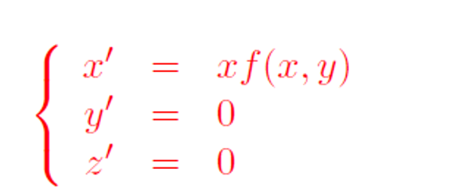
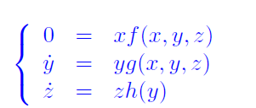
Artificial Singular Perturbation of Chemostat Model
The fast system:
The slow system:

Slide 35
Two Open Problems:
  Prove the existence of an artificial singular saddle-focus homoclinic orbit for ε = 0
  Continue the singular orbit to the chemostat model value ε = 1
  Numerically finding such an orbit for ε = 0 as initial guess
  Numerically finding such an orbit for ε = 1 , hence demonstrating chemostat chaos in silico
Settle for the next best result:

Slide 36
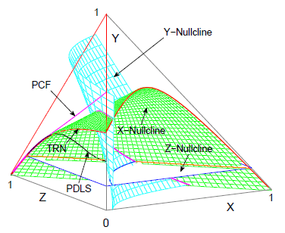
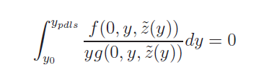
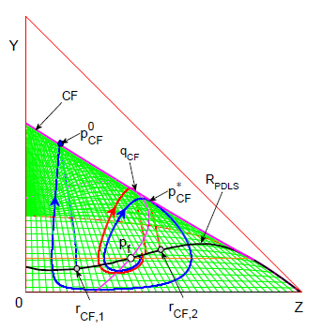
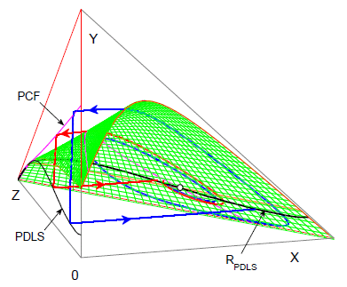
Pontryagin’s Delay of Lost Stability:

Slide 37
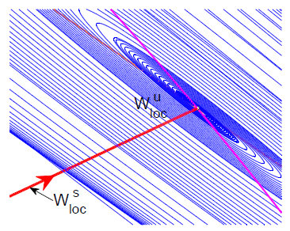
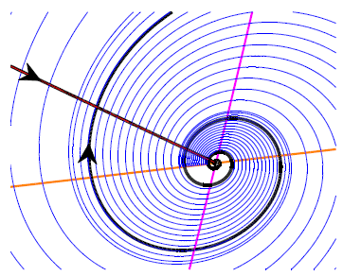
Use the tangent line (eigenspace) approximation for the local stable manifold
Use the tangent plane (eigenspace) approximation for the local unstable manifold. Specifically, use a set of initial points between one full spiral of a local unstable manifold orbit for the approximation
Neighborhood size ~ 10⁻⁴ leads to manifold approximation ~ 10⁻⁸

Slide 38
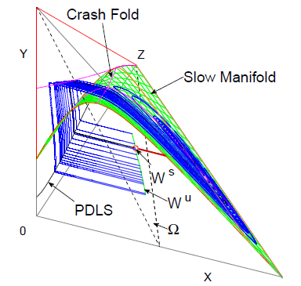
Plane for shooting: Ω
Define the intersection of the global stable manifold with the plane to be W ^{s}
Define the intersection of the global unstable manifold with the plane to be W ^{u}
Ω
The objective is to find parameter values so that
W ^{s} ϵ W ^{u}

Slide 39
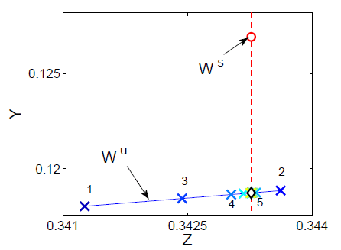
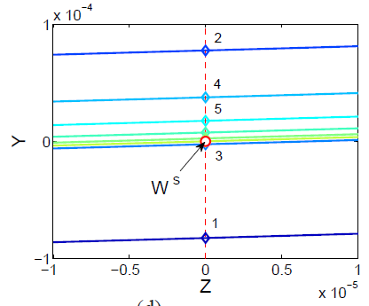
Shooting Algorithm
For fast convergence, bisection is used to find the closest unstable orbit to the stable manifold
Also for fast convergence, bisection is used to find one parameter value, a₂, to meet the shooting criterion: W ^{s} ϵ W ^{u}
25 Bisection steps lead to approximation errors < 10⁻⁸
On Ω
On Ω

Slide 40
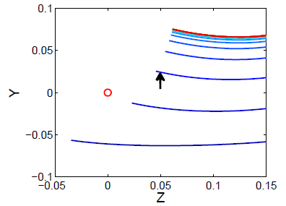
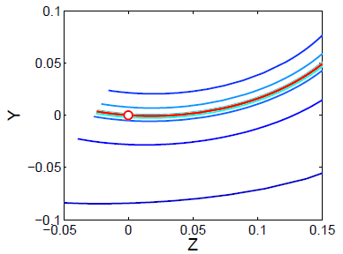
Shooting fails, no homoclinic orbits are found:
Shooting succeeds, one homoclinic orbit is found:
Ω
Ω

Slide 41
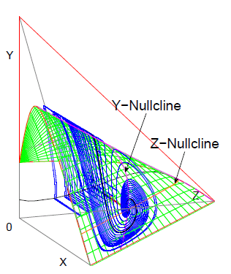

Homoclinic orbit for ε = 0.01 with returning error ~ 10⁻⁴
Homoclinic orbit for ε = 1 with returning error ~ 10⁻⁶

Slide 42



Near Smith-Waltman’s parameter values:
Homoclinic orbit for ε = 0.01 with returning error ~ 10⁻⁴
Homoclinic orbit for ε = 1 with returning error ~ 10⁻⁶
Permissible error < 10⁻²
Achieved error < 10⁻⁶
Ω
Ω

Slide 43
Summary:
Chemostat chaos is proved in silico
Two open problems remain for a rigorous proof:
(1) the existence of an artificial singular homoclinic orbit
(2) its continuation to the chemostat value ε = 1
There are many open problems for the existence of chaos in ecological and epidemiological models
Many of them are not demonstrated conclusively numerically

Slide 45
Title: How to Prove Shilnikov Chaos for Chemostat Model
Abstract: A classical chemostat model was known to exhibit complex dynamics more than 20 years ago. It is still an open problem
to prove the existence of chaos analytically. In this talk I will present a numerical proof for the problem. This is to be done by first
finding a plausible parameter region through singular perturbation analysis of a modified model, and then finding a Shilnikov's
saddle-focus homoclinic orbit, which is chaos generating, of the non-modified model by a shooting algorithm. We will also discuss
Shilnikov's classical result and talk about possible application of our numerical method to other ecological and epidemiological models.

