Slide 1
Simulating Biodiversity ---- from random mutation to natural selection to ecological stability
Bo Deng
Dept. of Math. UNL
Sept. ‘09

Slide 2
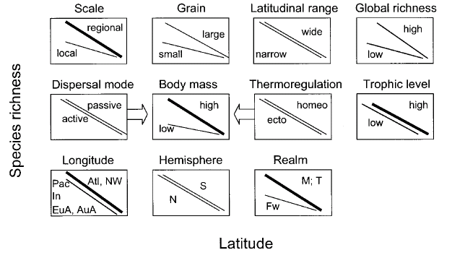
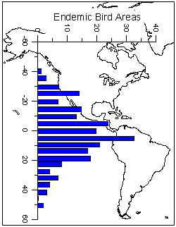
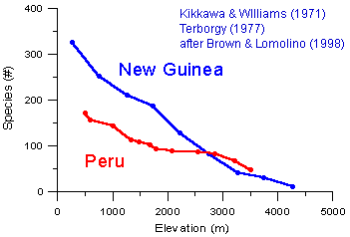
http://www.geo.arizona.edu/Antevs/ecol438/lect03.html#05
Latitude Diversity Gradient
Hillebrand (2004) on 600 studies

Slide 3
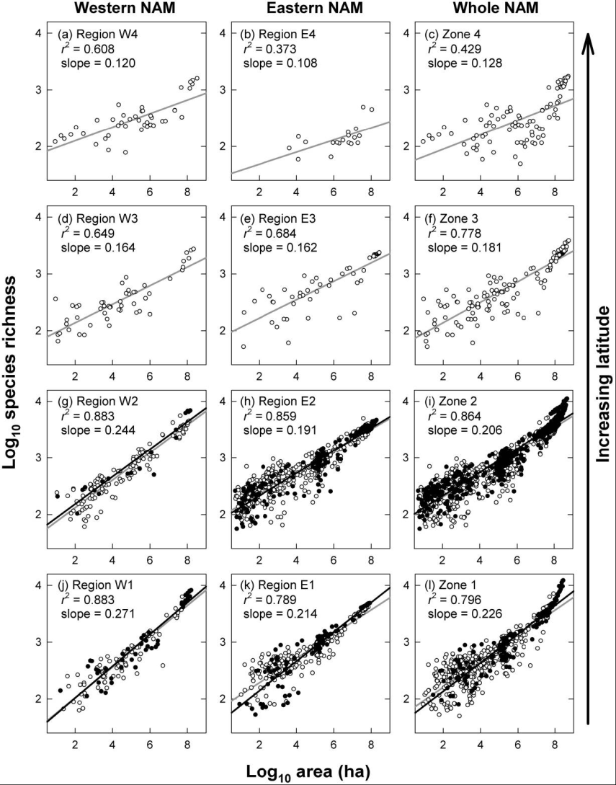
For vascular plant floras (Qian, et. al 2007)

Slide 4
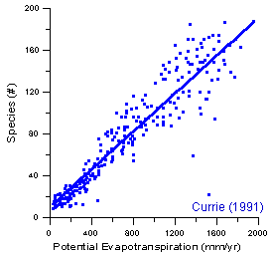
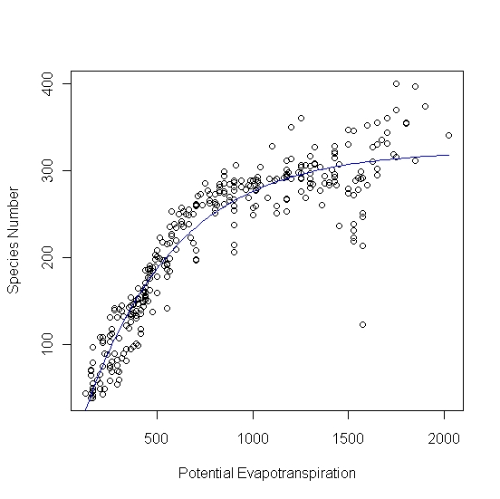
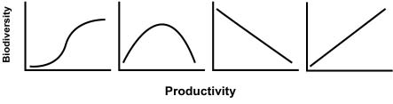
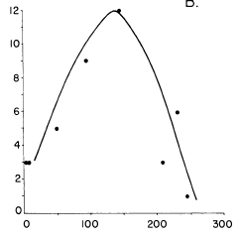
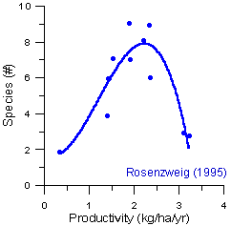
Left: North American Vertebrates, Nonvolant (nonflying). Right: Including reptiles, birds, etc.
Currie(1991)
Gobi Desert Rodent
Plant Number
Lubchenco(1978)
Herbivore Density
http://www.geo.arizona.edu/Antevs/ecol438/lect03.html#05

Slide 5
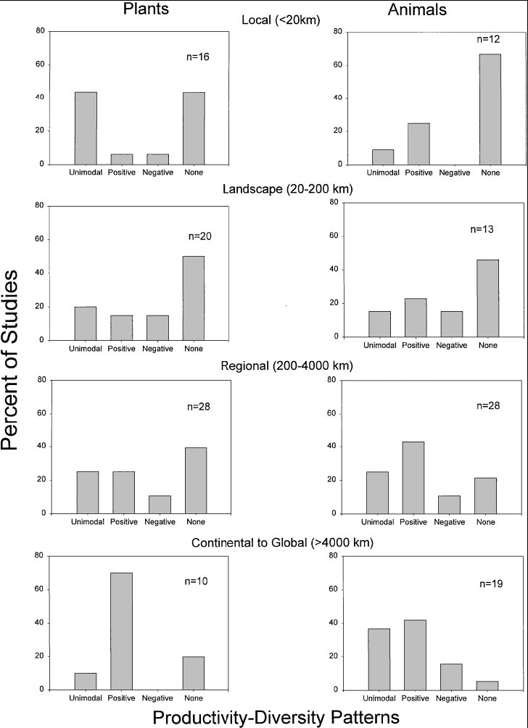
Waide, et. al. (1999), Annu. Rev. Ecol., on 201 studies
Summary

Slide 6
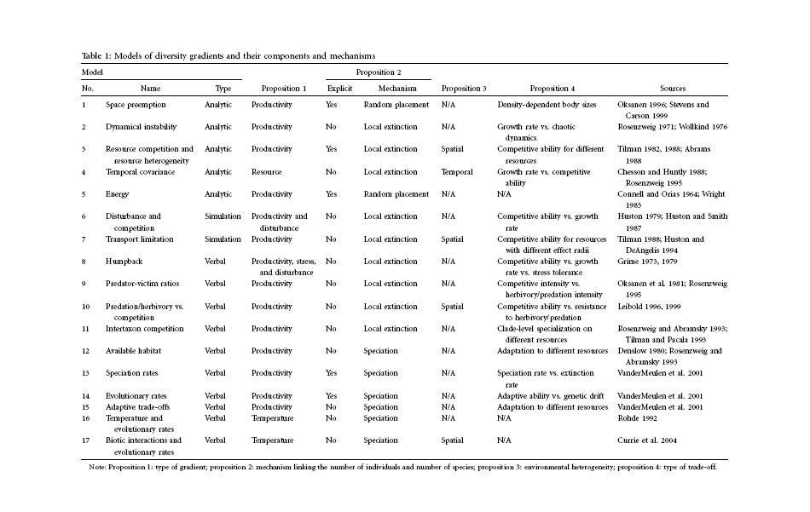
(Scheiner & Willig 2005)

Slide 7
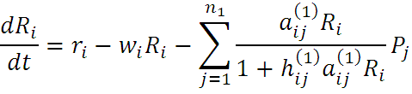

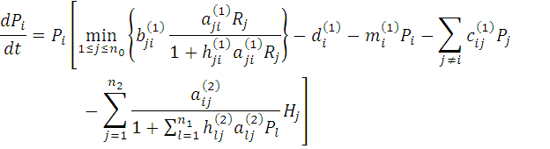

Variables
C = (C₁, C ₂, … , C _{n3})’
H = (H ₁, H ₂, … , H _{n2})’
P = (P ₁, P ₂, … , P _{n1})’
R = (R ₁, R ₂, … , R _{n0})’

Slide 8








Parameters
--- Resource input rate
--- Resource depletion coefficient rate
--- Contact or discovery rate
--- Processing or handling time
--- Birth-to-consumption ratio
--- Per-capita death rate
--- Intra-specific competition parameter rate
--- Inter-specific competition parameter rate
Trophic level: plants (k = 1), herbivores (k = 2), carnivores (k = 3)

Slide 9
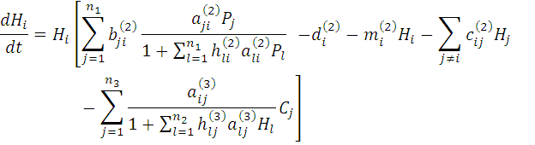




Slide 10





In Matlab syntax
,
,
, etc.

Slide 11
n₀ = 4, n₁ = 100, n₂ = 100, n₃ = 50
Resource | Value | Plant | Value | Herbivore | Value | Carnivore | Value
 | 0.1
 |  |  | 0.1 |  | 0.01 |  | 0.1
 |  |  |  |  |  |  | 0.01
 |  |  |  |  | 0.1 |  | 0.1
 |  |  | 0.1 |  |  |  | 0.1
 |  |  | 0.1 |  | 1 |  | 10
 |  |  |  |  | 0.1 |  | 1
In Matlab, e.g., , etc.

Slide 16
Effects of inter-specific competitions
But when we bear in mind that almost every species would increase
immensely in numbers were it not for other competing species …
Charles Darwin, On the Origin of the Species

Slide 17
Effects of intra-specific competitions

Slide 18
Biomass v.s. Species Richness

Slide 19
d
Biomass
r₀

Slide 21
Effect of Species Pool

Slide 22
Definition: Species X is competitive in a foodweb if the time
average of its per-capita growth rate dX/dt/X is
positive along the steady state of the web without X.
Theorem: A competitive species can always invade the foodweb,
but a non-competitive species cannot. With intra-
specific competition (m_0 > 0), competitive species
can always be constructed in theory to invade a web.
Theorem: Competitive exclusion occurs without intra-specific
competition (m_0 = 0) , but the model becomes
pathological in which individual organisms
would have multiple lifes.
‘Theorem’: Without inter-specific competition (c_0 = 0) but
with intra-specific competition (m_0 > 0), all
species will eventually become competitive and
coexist at an equilibrium state as the resources
become sufficiently abundant.
Stable but fragile : A competitive species X is not always competitive in every
subweb of its community, i.e., the timing of its speciation
or invasion to the web determines its evolutionary success.

Slide 23
Assuming the one-life rule, resource abundance is the determining factor for stability
Resources and competitions are the determining factors for diversity
Diversity and stability or productivity should not bear causal relationship to each other
Because of predation, diversity loss is inevitable even under some ‘best’ circumstances in resource abundance

Slide 24


Neo-Darwinism
Darwinism
Evolution Axis
Evolution Axis
Mutation Field

Slide 25
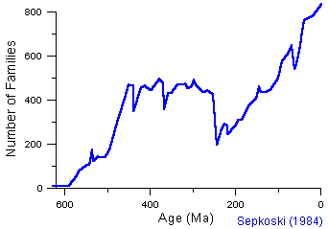
Diversity through time
http://www.geo.arizona.edu/Antevs/ecol438/lect03.html#05

Slide 27
Adapted from Waide, et. al. (1999), Annu. Rev. Ecol. (201 studies)

