Slide 1
An Optimization Model that Links Masting to Seed Herbivory
Glenn Ledder, gledder@math.unl.edu
Department of Mathematics
University of Nebraska-Lincoln

Slide 2
Background
Masting is a life history strategy in which reproduction is deferred and resources hoarded for “big” reproduction events.

Slide 3
Background
Masting is a life history strategy in which reproduction is deferred and resources hoarded for “big” reproduction events.
A tree species in Norway exhibits masting with periods of 2 years or 3 years based on geography. Any theory of masting must account for periodic reproduction with conditional period length.

Slide 4
Background
Masting often occurs at a population level. For simplicity, we assume either that individuals are isolated or that coupling is perfect, removing the issue of synchrony.

Slide 5
Background
Masting often occurs at a population level. For simplicity, we assume either that individuals are isolated or that coupling is perfect, removing the issue of synchrony.
The Iwasa-Cohen life history model predicts both annual and perennial strategies, but not masting.

Slide 6
Biological Question
What features of a plant’s physiology and/or ecological niche can account for masting?

Slide 7
Biological Question
What features of a plant’s physiology and/or ecological niche can account for masting?
Fundamental Paradigm
Natural selection “tunes” a genome to achieve optimal fitness within its ecological niche.

Slide 8
Biological Question
What features of a plant’s physiology and/or ecological niche can account for masting?
Fundamental Paradigm
Natural selection “tunes” a genome to achieve optimal fitness in its ecological niche.
Simplifying Assumption
Optimal fitness in a stochastic environment is roughly the same as optimal fitness in a fixed mean environment.

Slide 9

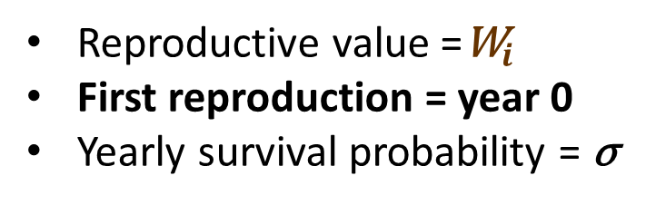

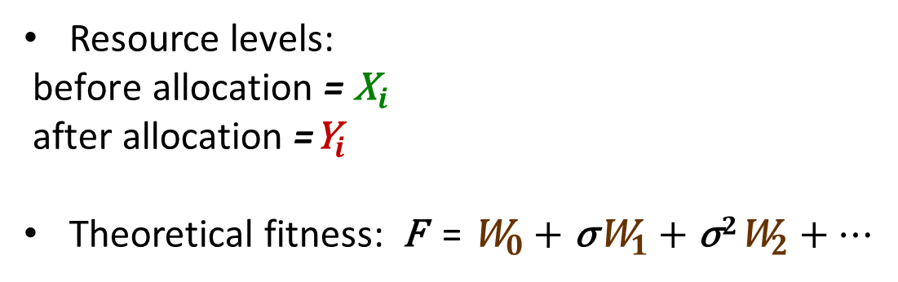


Model Structure
$${\text{X}}_{0}$$
Growth
X_{i} = ψ ( Y_{i-1} )
$${\text{X}}_{i}$$
Allocation
Y_{i} = Y ( X_{i} )
Reproduction
W_{i} = W ( X_{i} – Y_{i} )
$${\text{W}}_{i}$$
$${\text{Y}}_{i}$$
Resource levels:
${\text{before} \text{allocation}\text{ = }\text{X}}_{i}$
${\text{after} \text{allocation}\text{ =}\text{Y}}_{i}$
Theoretical fitness: F = ${\text{W}}_{0}$ $+$ ${\text{σ}\text{W}}_{1}+{\text{σ}2\text{W}}_{2}+$ ⋯
Reproductive value =${\text{W}}_{i}$
First reproduction = year 0
Yearly survival probability = σ

Slide 10
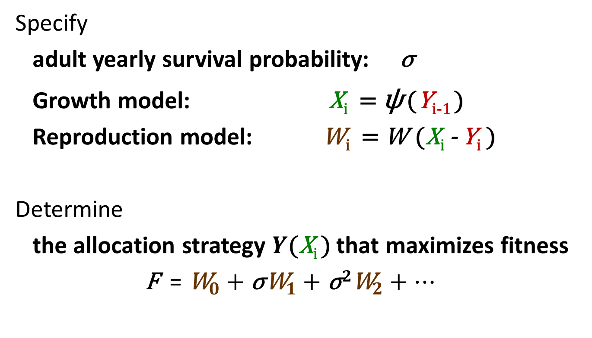
The Optimization Problem
Specify
adult yearly survival probability: σ
Growth model: X_{i} = ψ (Y_{i-1} )
Reproduction model: W_{i} = W ($\text{X}\text{i}$ - Y_{i} )
Determine
the allocation strategy $Y\text{(}\text{X}\text{i}$) that maximizes fitness
F = ${\text{W}}_{0}$ $+$ ${\text{σ}\text{W}}_{1}+{\text{σ}2\text{W}}_{2}+$ ⋯

Slide 11
Growth Model
Mathematical Properties:
No input means no output ψ (0) = 0
Excess input is not wasted ψ′ ≥ 1
Additional input has diminishing returns ψ′ ≤ 0
The specific function is determined by an optimization problem for the growing season.

Slide 12
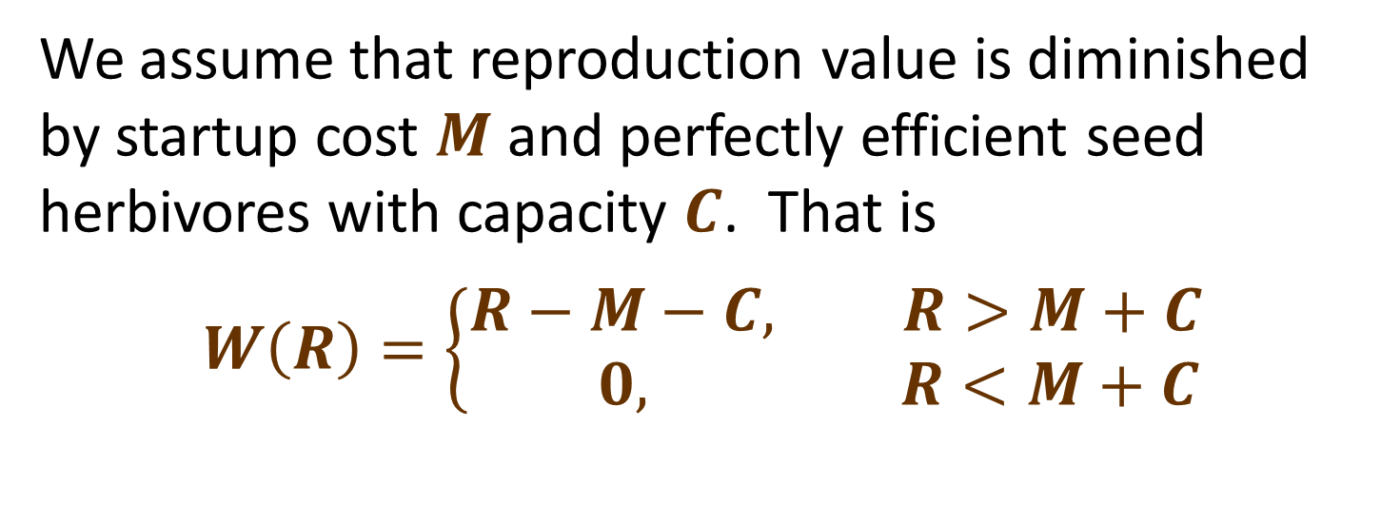
Reproduction Model
We assume that reproduction value is diminished by startup cost $M$ and perfectly efficient seed herbivores with capacity $C$. That is
$$W\left(R\right)=\left\{\begin{matrix}R−M−C, R>M+C \\ 0, R<M+C\end{matrix}\right.$$

Slide 13

Preferred-Storage Allocation: An Important Special Case
The formula
F = ${\text{W}}_{0}$ $+$ ${\text{σ}\text{W}}_{1}+{\text{σ}2\text{W}}_{2}+$ ⋯
is difficult to compute.

Slide 14
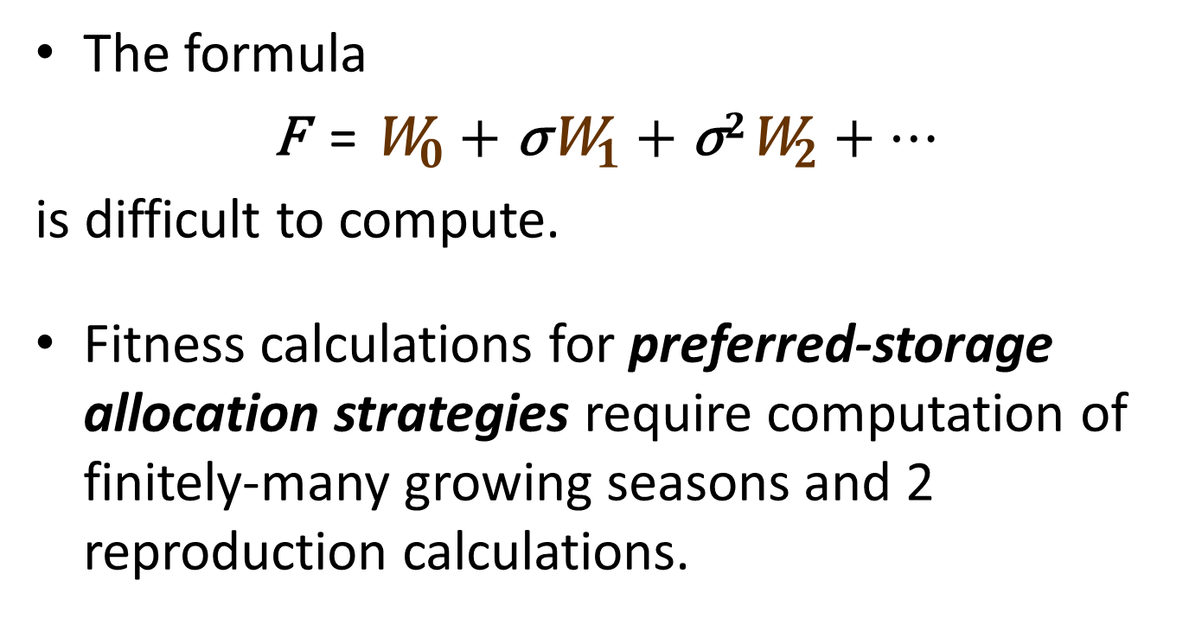
Preferred-Storage Allocation: An Important Special Case
The formula
F = ${\text{W}}_{0}$ $+$ ${\text{σ}\text{W}}_{1}+{\text{σ}2\text{W}}_{2}+$ ⋯
is difficult to compute.
Fitness calculations for preferred-storage allocation strategies require computation of finitely-many growing seasons and 2 reproduction calculations.

Slide 15
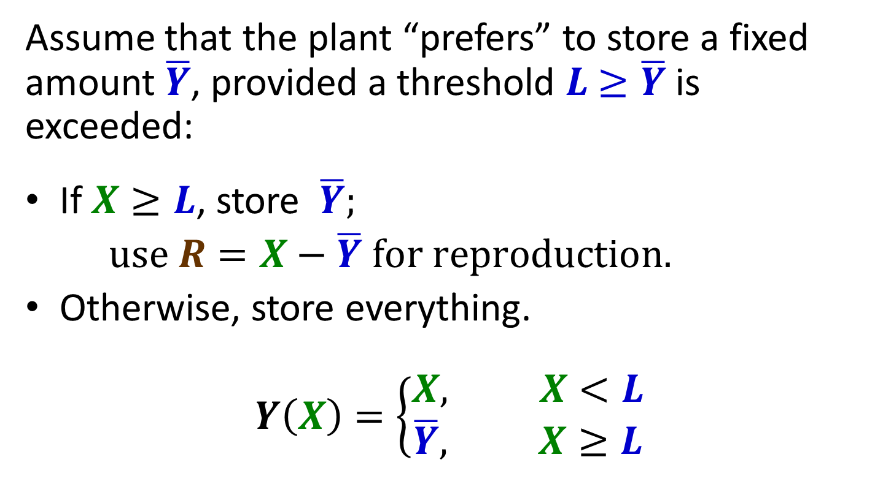
Preferred-Storage Allocation
Assume that the plant “prefers” to store a fixed amount $\overline{Y}$, provided a threshold $L$ $≥\overline{Y}$is exceeded:
If $X≥L$, store $\overline{Y};$
$use R=X−\overline{Y} for reproduction.$
Otherwise, store everything.
$$Y\left(X\right)=\left\{\begin{matrix}X, X<L \\ \overline{Y}, X≥L\end{matrix}\right.$$

Slide 16










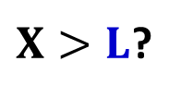


Preferred-Storage Fitness
$$\overline{Y}$$
$$ψ_{j+1}\left(X_{0}\right)$$
$$j=J$$
$${R_{J}=ψ}_{J}\left(X_{0}\right)−\overline{Y}$$
$$ψ$$
$X>L$?
$$Y$$
$${R_{2J}=ψ}_{J}\left(X_{0}\right)−\overline{Y}$$
$$ψ_{j}\left(X_{0}\right)$$
$${R_{3J}=ψ}_{J}\left(X_{0}\right)−\overline{Y}$$
$$j<J$$
$$\overline{Y}$$
$$⋮$$

Slide 17



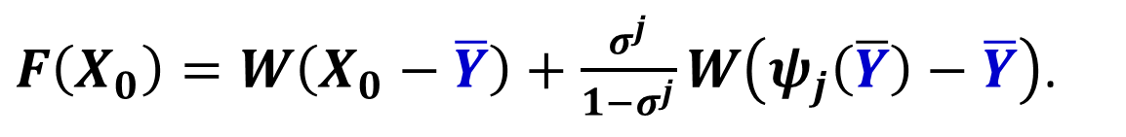

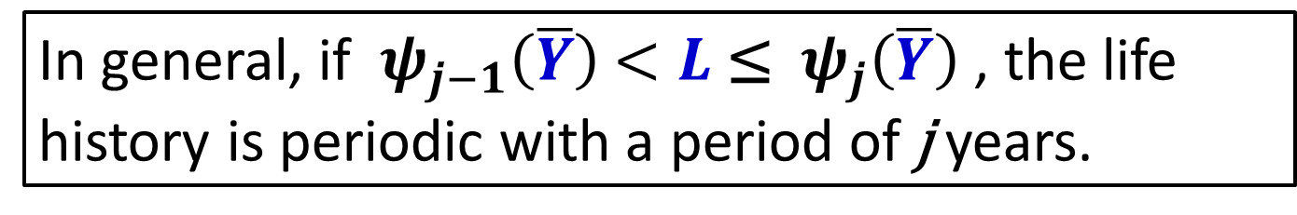

Preferred-Storage Fitness
$$\overline{Y}$$
$$ψ_{j+1}\left(\overline{Y}\right)$$
$$j=J$$
$${R_{J}=ψ}_{J}\left(\overline{Y}\right)−\overline{Y}$$
$$ψ$$
$X>L$?
$$Y$$
$${R_{2J}=ψ}_{J}\left(\overline{Y}\right)−\overline{Y}$$
$$ψ_{j}\left(\overline{Y}\right)$$
$${R_{3J}=ψ}_{J}\left(\overline{Y}\right)−\overline{Y}$$
$$j<J$$
$$\overline{Y}$$
$$⋮$$
In general, if ${ ψ}_{j−1}\left(\overline{Y}\right)$ $<L$ ≤ ${ ψ}_{j}\left(\overline{Y}\right)$ , the life history is periodic with a period of j years.
$F\left(X_{0}\right)=W\left(X_{0}−\overline{Y}\right)+\frac{σ^{j}}{1−σ^{j}}W\left(ψ_{j}\left(\overline{Y}\right)−\overline{Y}\right)$.

Slide 18
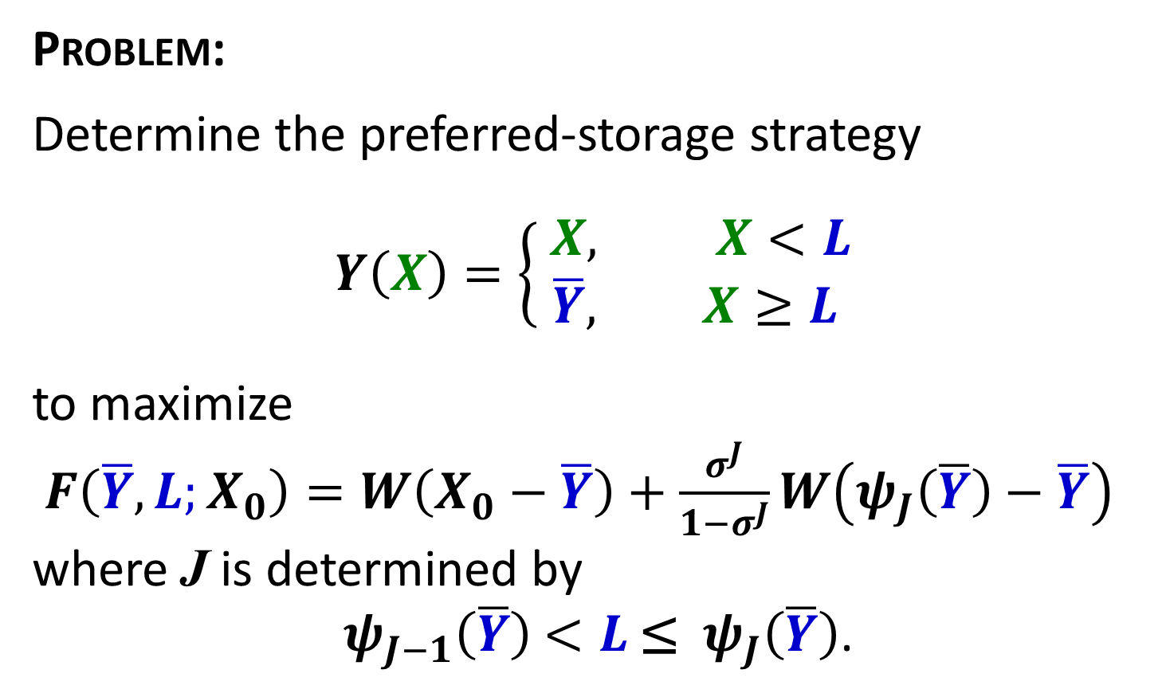
Optimal Preferred-Storage Strategy
Problem:
Determine the preferred-storage strategy
$$Y\left(X\right)=\left\{\begin{matrix} X, X<L \\ \overline{Y}, X≥L\end{matrix}\right.$$
to maximize
$F\left(\overline{Y}, L;X_{0}\right)=W\left(X_{0}−\overline{Y}\right)+\frac{σ^{J}}{1−σ^{J}}W\left(ψ_{J}\left(\overline{Y}\right)−\overline{Y}\right)$
where J is determined by
${ ψ}_{J−1}\left(\overline{Y}\right)$ $<L$ ≤ ${ ψ}_{J}\left(\overline{Y}\right)$.

Slide 19
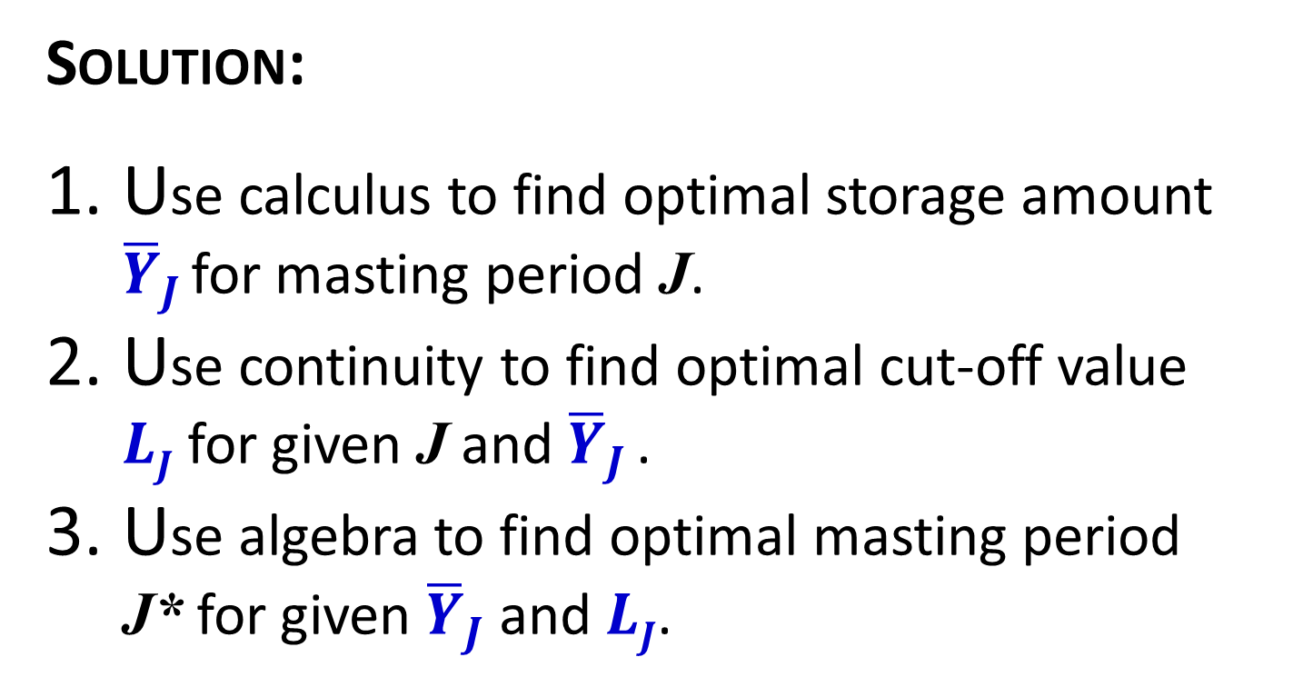
Optimal Preferred-Storage Strategy
Solution:
Use calculus to find optimal storage amount ${\overline{Y}}_{J }$for masting period J.
Use continuity to find optimal cut-off value $LJ$ for given J and ${\overline{Y}}_{J }$.
Use algebra to find optimal masting period J* for given ${\overline{Y}}_{J}$ and $LJ$.

Slide 20
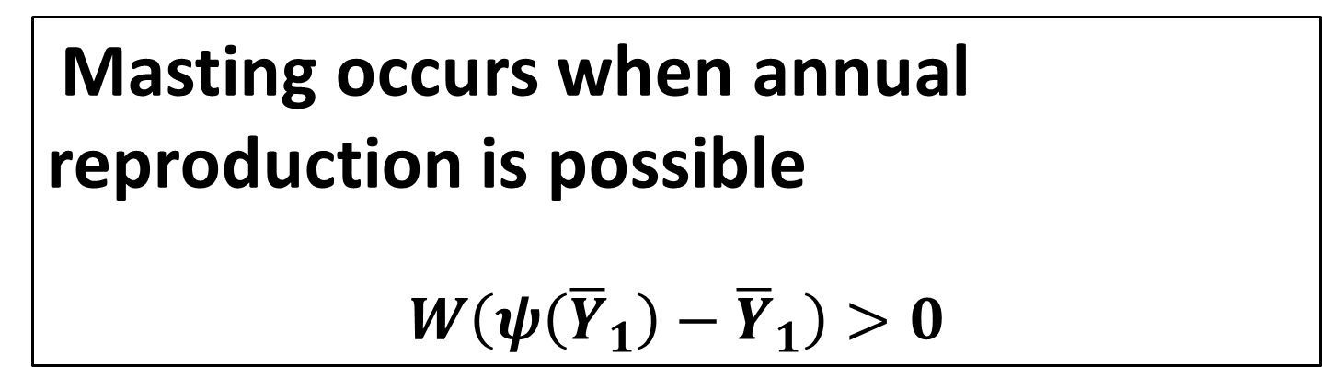
Optimal Preferred-Storage Strategy
Masting occurs when annual reproduction is possible
$$W\left(ψ\left({\overline{Y}}_{1}\right)−{\overline{Y}}_{1}\right)>0$$

Slide 21
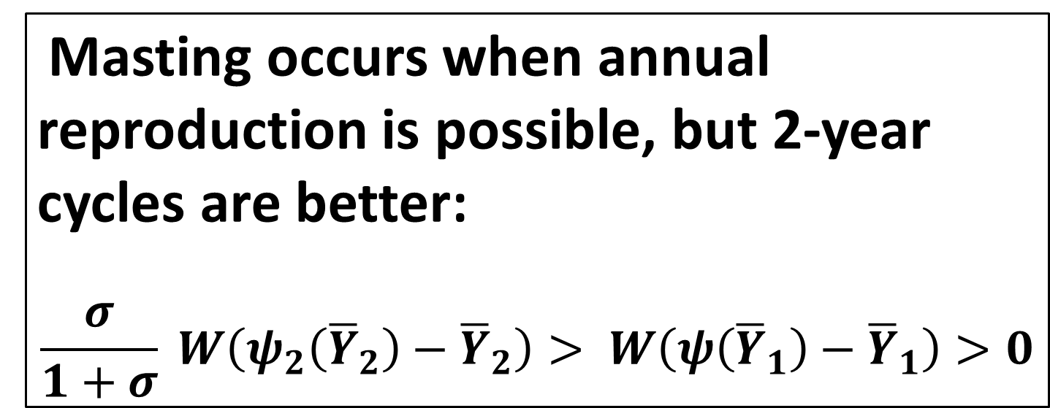
Optimal Preferred-Storage Strategy
Masting occurs when annual reproduction is possible, but 2-year cycles are better:
$$\frac{σ}{1+σ} W\left(ψ_{2}\left({\overline{Y}}_{2}\right)−{\overline{Y}}_{2}\right)> W\left(ψ\left({\overline{Y}}_{1}\right)−{\overline{Y}}_{1}\right)>0$$

Slide 22
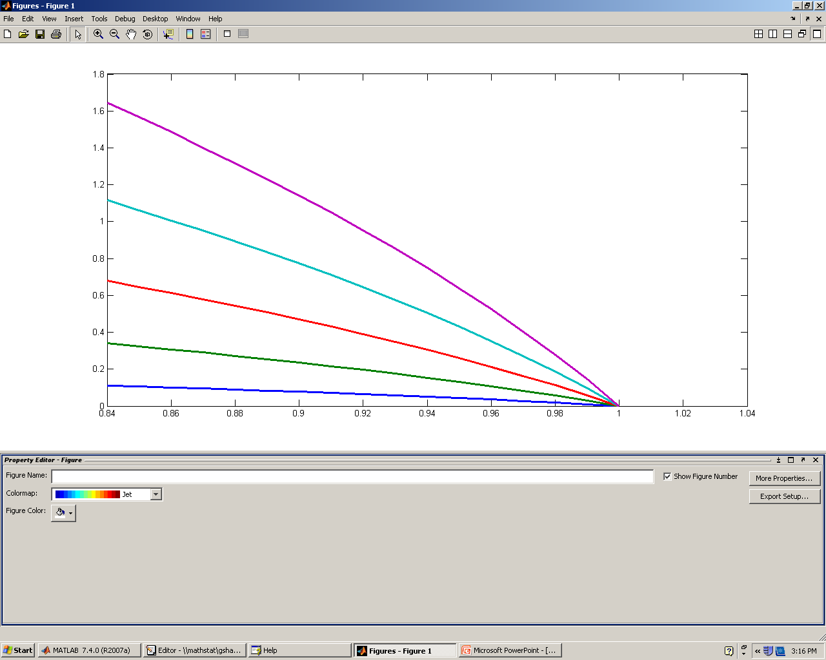
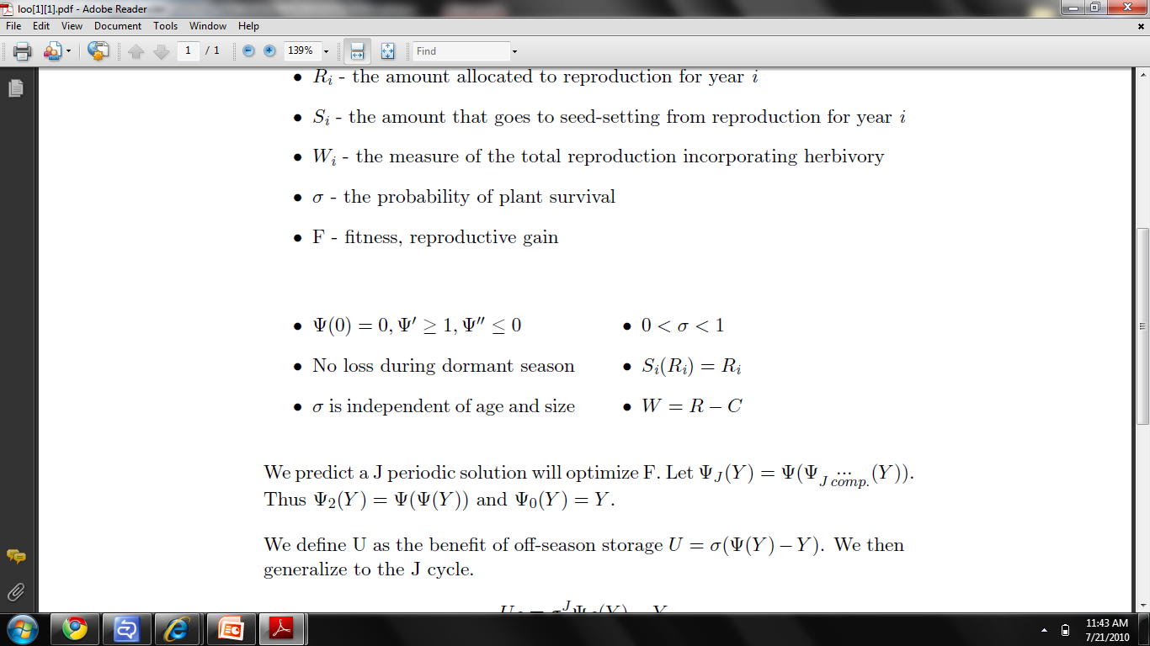
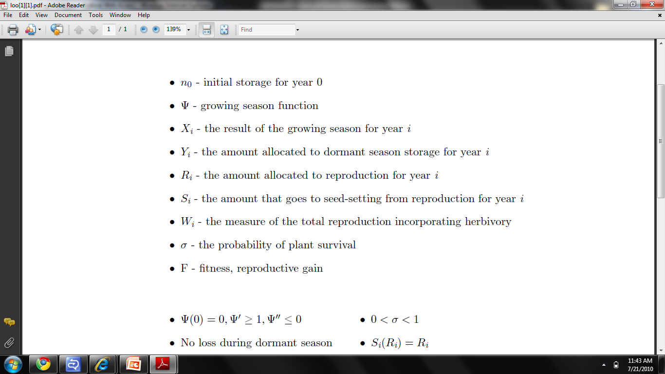
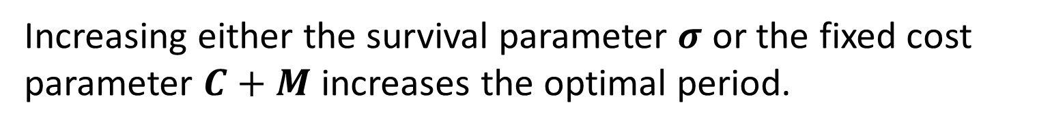
Masting Period
C +M
J=5
J=4
J=3
J=2
J=1
σ
Increasing either the survival parameter $σ$ or the fixed cost parameter $C+M$ increases the optimal period.
J = 5
J = 4
J = 3
J = 1
J = 2
The optimal periodicity given herbivory and survival probability.

Slide 23
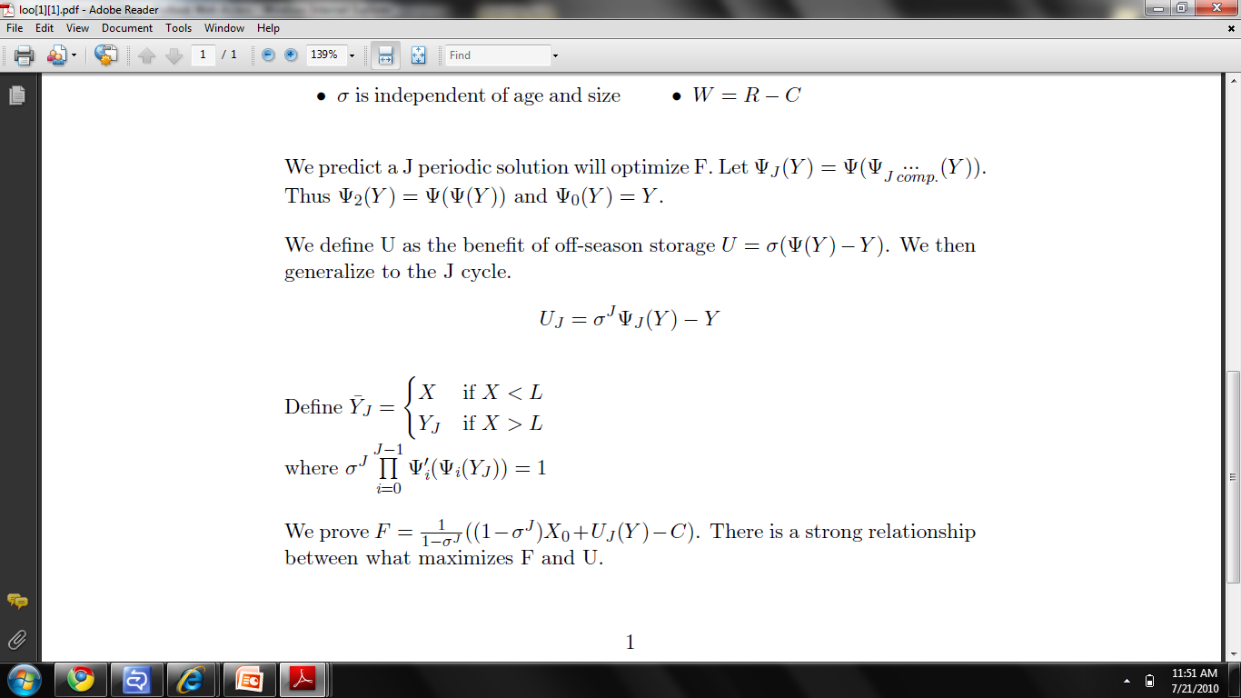
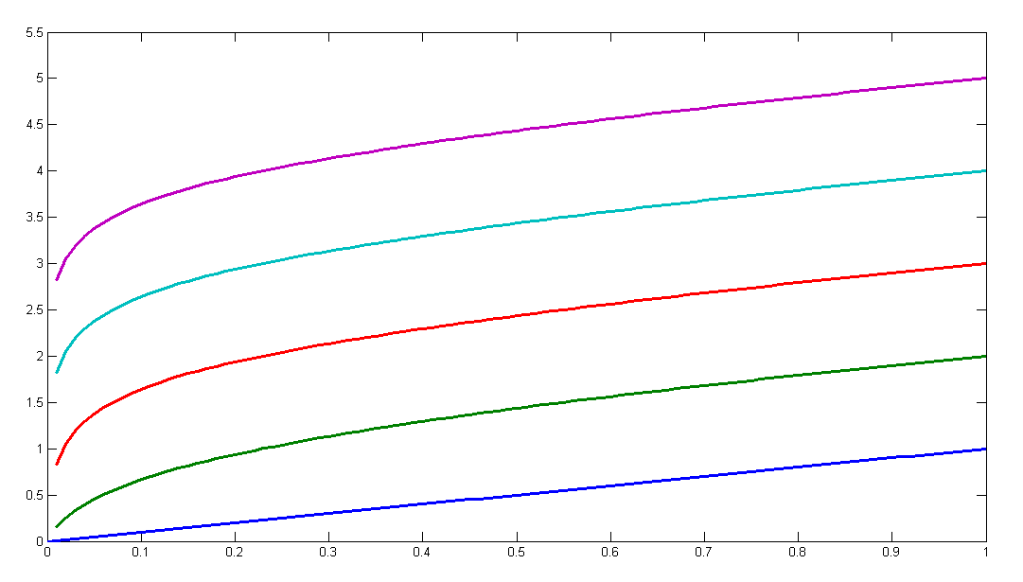

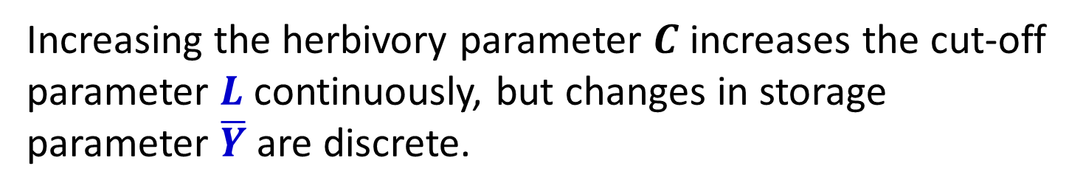
Allocation Parameters
J = 5
J = 4
J = 3
J = 2
J = 1
Increasing the herbivory parameter $C$ increases the cut-off parameter $L$ continuously, but changes in storage parameter $\overline{Y}$ are discrete.

Slide 24
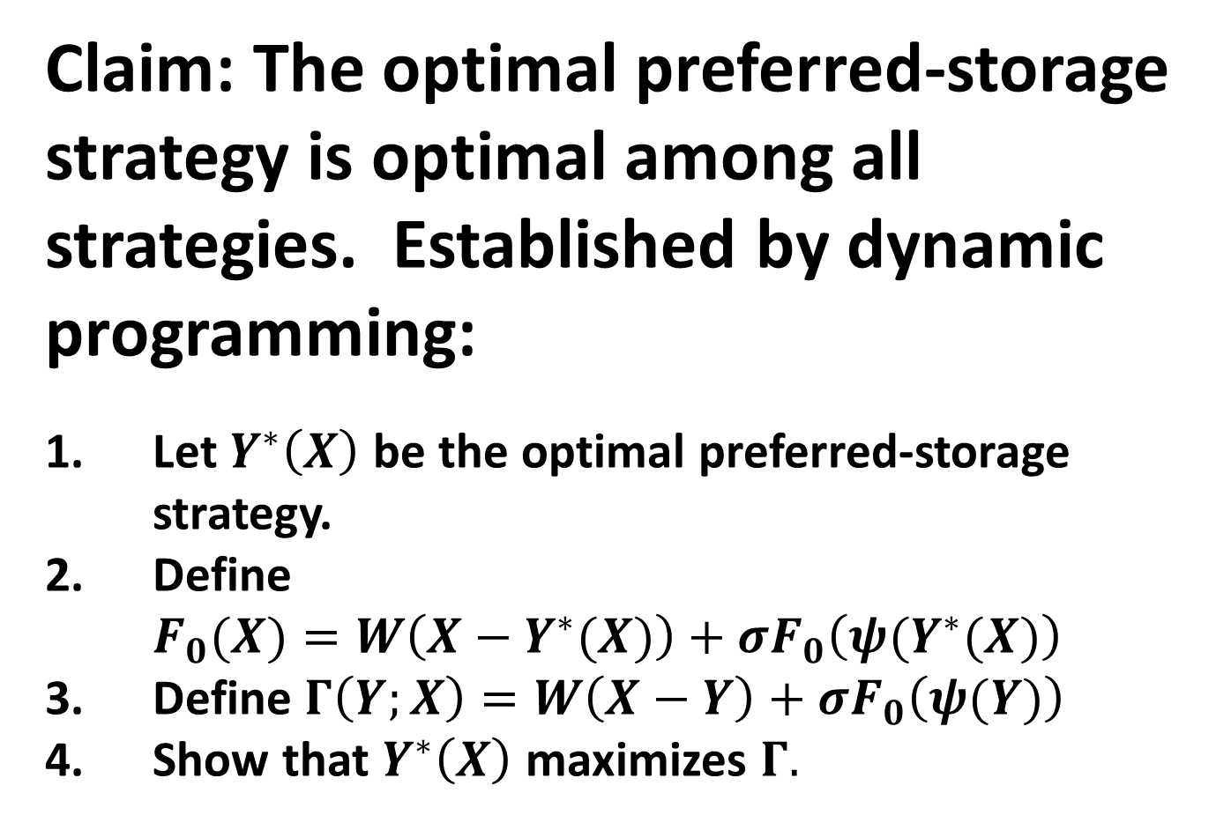
Claim: The optimal preferred-storage strategy is optimal among all strategies. Established by dynamic programming:
Let $Y^{∗}\left(X\right)$ be the optimal preferred-storage strategy.
Define $F_{0}(X)=W\left(X−Y^{∗}(X)\right)+σF_{0}\left(ψ(Y^{∗}(X)\right)$
Define $Γ\left(Y;X\right)=W\left(X−Y\right)+σF_{0}\left(ψ(Y)\right)$
Show that $Y^{∗}\left(X\right)$ maximizes $Γ.$

